Slide 1


Community toolkit for adults and people who are shielding
Community toolkit for older adults and people who are shielding
Information correct as of Wednesday 8 July 2020
#KeepingBarnsleyMoving

Slide 2
Key information and messages for conversations in our community
Key information and messages for conversations in the community
There are several changes to the guidance for people who are shielding from Monday 6 July, and more changes will be introduced from Saturday 1 August. These can be found here: https://www.gov.uk/government/publications/guidance-on-shielding-and-protecting-extremely-vulnerable-persons-from-covid-19/guidance-on-shielding-and-protecting-extremely-vulnerable-persons-from-covid-19.
Some key changes from 6 July include:
  You no longer need to socially distance from people you live with
  If you want to, you can meet in a group of up to 6 people outdoors, including people from other households
  You may also form a ‘support bubble’ with one other household if you want to, but one of the households in the ‘support bubble’ should be a single adult household
#KeepingBarnsleyMoving

Slide 3
Key information and messages for conversations in the community
Key information and messages for conversations in the community
Locally, older people can get free information and advice by calling Age UK Barnsley on 01226 776825, from 9am – 4pm Monday to Friday. People can also email information@ageukbarnsley.org.uk.
Older people should also follow measures to control the Coronavirus (COVID-19):
  Keep your distance and stay apart
  Wash your hands regularly
  Wear a face-covering where advised
  Stay at home as much as possible
  Don’t leave home if you or anyone in your household has symptoms and get tested
  Work from home if you can
  Protect our community and don’t be a contact
#KeepingBarnsleyMoving

Slide 4
Useful links to share with people
Useful links to share with people
Emergency support for vulnerable people: https://www.barnsley.gov.uk/services/health-and-wellbeing/covid-19-coronavirus-advice-and-guidance/covid-19-coronavirus-contact-centre/.
Other local information: https://www.barnsley.gov.uk/services/health-and-wellbeing/covid-19-coronavirus-advice-and-guidance/.
Government shielding advice: https://www.gov.uk/government/publications/guidance-on-shielding-and-protecting-extremely-vulnerable-persons-from-covid-19/guidance-on-shielding-and-protecting-extremely-vulnerable-persons-from-covid-19.
#KeepingBarnsleyMoving

Slide 5






Local outbreaks
Local outbreaks
Our Local Outbreak Plan is in place ensuring we are well prepared to effectively contain the Covid-19 virus and reduce its spread in the community. Our arrangements for Barnsley are robust and ready to deal with any local cases.
keep your distance and stay apart - follow government guidelines
wash your hands regularly
wear a face-covering where advised
stay at home as much as possible
don't leave home if you or anyone in your household has symptoms and get tested
work from home if you can
#KeepingBarnsleyMoving

Slide 6
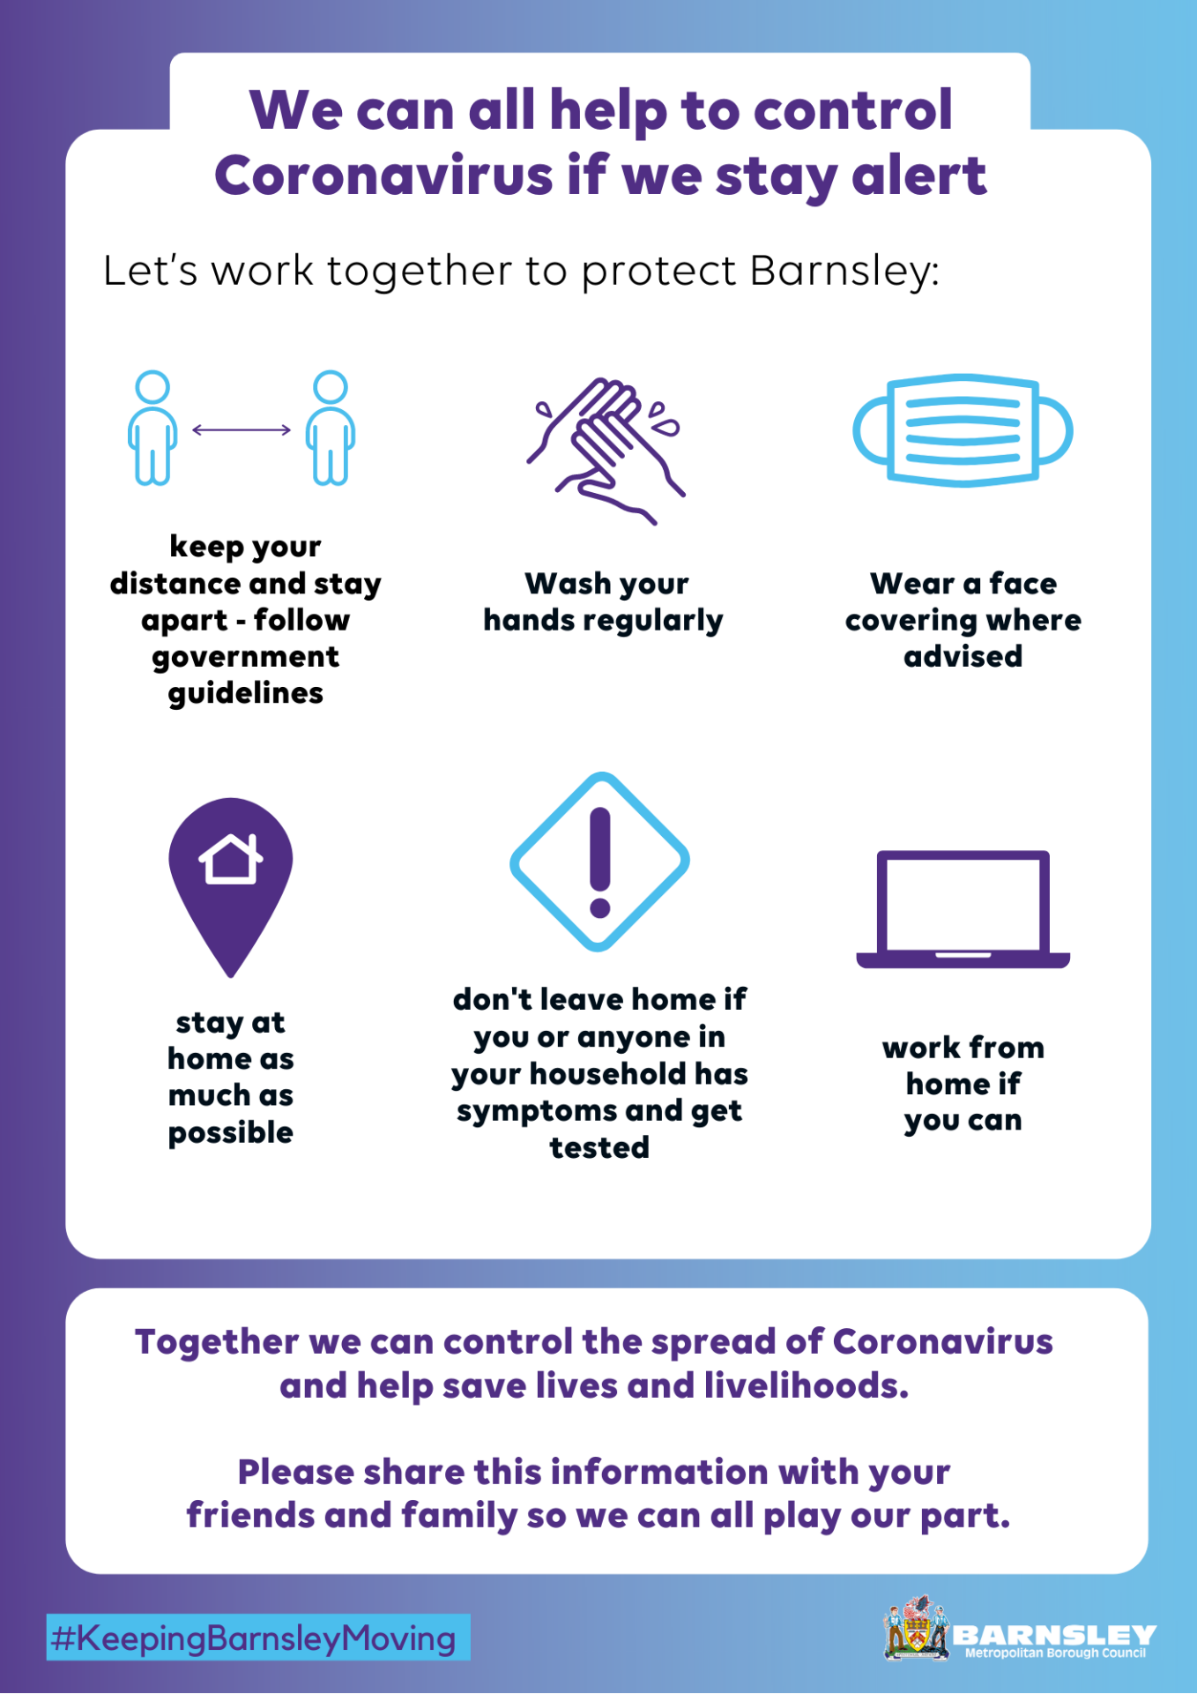
Poster
Poster
We have an A4 poster that you can download and print to put up in community centres, notice boards or places of work.
It includes key measures to help stay alert and control Coronavirus (COVID-19).
#KeepingBarnsleyMoving

Slide 7
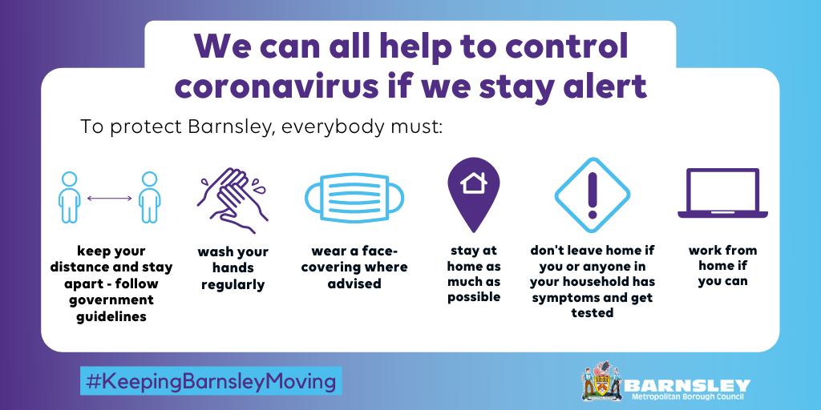
Social media
Social media
1) Everyone’s actions have an impact on the transmission of Coronavirus (COVID-19) in our communities. It’s still really important that we continue to stay alert and keep each other safe by following social distancing measures, staying apart and limiting contact with others.
We have example social media posts that you can use on your channels, with pictures to go alongside them.
2) If you or anyone in your household develops symptoms of Coronavirus (COVID-19), you must stay at home and get a test to confirm whether you have the virus. Find out how to get tested at nhs.uk/coronavirus.
3) Although lockdown measures are being eased, the virus is still out there so please make sure you are still following government guidelines. Take a look at what you can and can't do at https://bit.ly/2VKfnAj.
#KeepingBarnsleyMoving

Slide 8
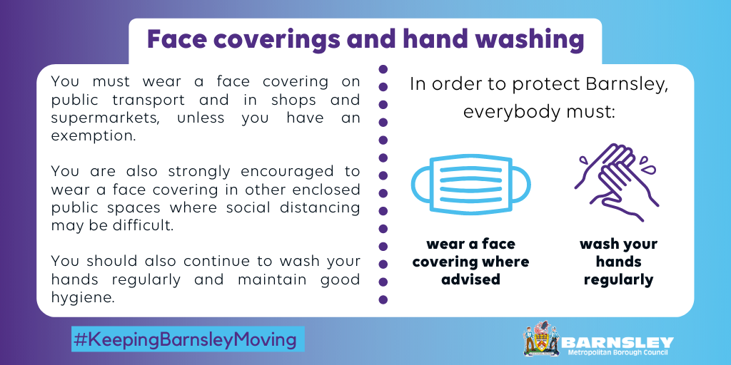
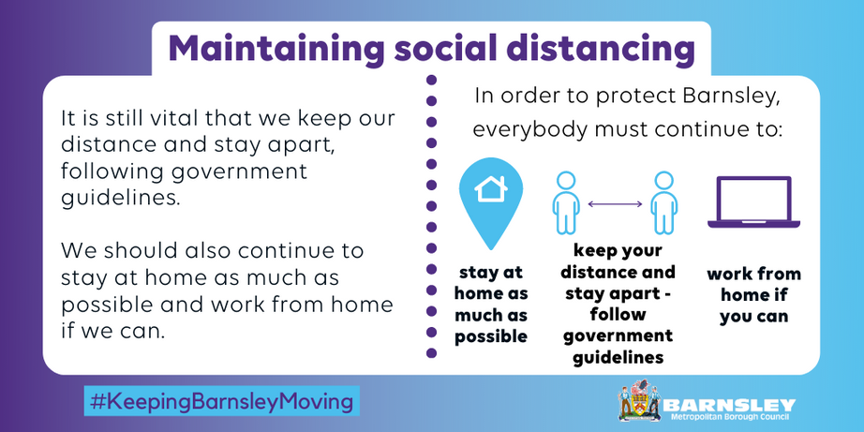
Social media further information
Social media
4) There are several things you can do to reduce the transmission of Coronavirus. Keep your distance and stay at home as much as possible, wash your hands, wear a face covering where advised, don’t leave home if you or anyone in your household has symptoms and get a test.
#KeepingBarnsleyMoving

