Slide 1
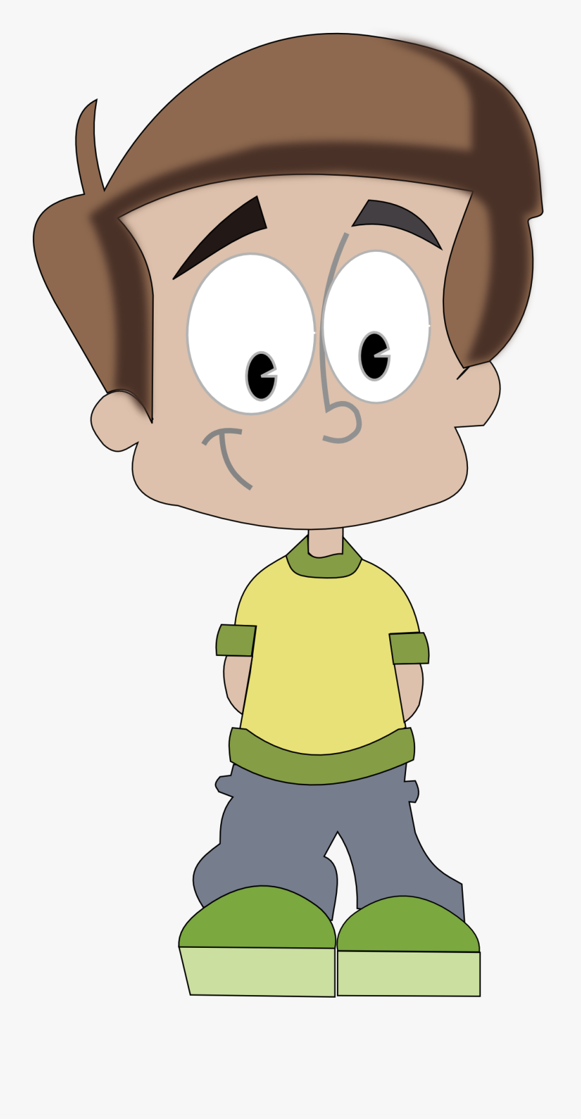

*Kaleb’s Story
Written by Emma Fox (Children’s Safeguarding Advisor) using Kaleb’s words and account of events.
Additional information taken from documentation within case notes.
Full informed consent was gained from Kaleb for this story to be written and shared for learning and reflection.

Slide 2
Hi, my name is Kaleb*, I am 14 years old and I would like to share my story with you about my time at hospital.
I was brought to hospital by my school teachers, they came to my house to check on me as they were worried about me when I didn’t turn up for school.
I live with my Dad, I haven’t always though. I used to live with my Grandad but he died 2 years ago. That’s when I was allowed to go back and live with my Dad. I like living with my Dad but I worry a lot about him.
It had just been my 14th birthday when school found me at home on my own. I had not been to school for a little while. I didn’t feel very well that day when they knocked on my door, they were so worried about me and brought me to the hospital.
Dad wasn’t at home when my teachers came to look for me, the police had taken him away the night before but I am not sure why, I was worried.
When I got to the hospital everyone was really nice and friendly, but I felt really rubbish. My body was a shaking a lot, I felt on edge and very nervous. I felt sick, tired and confused. I have felt like this before but this was far worse. Staff asked me questions and chatted to me about why I felt like this. They worked out that it was because I was using drugs which was my normal day to day life.
I smoke heroin, it first started with a little weed one time, I used more and more and it became worse and led me to smoke heroin/ gear/ brown. I get heroin by asking friends, sometimes I ask people for money to go to my dealer. I also take it from my Dad sometimes, when he’s not looking.
I use heroin every day, there are friends of my Dad’s that come over all the time, we chill and chat, and smoke together in the living room. I always make sure I tidy up when Dads friends have gone in case the police ever come, I don’t want my Dad to be in trouble.
I really needed help.

Slide 3
When I was in the hospital people were really nice to me, they didn’t judge me. They helped me feel better, stopped the sickness and the pains. It was here I met my new social worker, Rebecca*. She was really nice and told me what was happening with my Dad. The police have taken my phone off me so I cant ring or text anyone. Rebecca told me I needed to go live away from my Dad as he couldn’t look after me anymore. She told me I needed to live away from where there was drug use and that I needed looking after. This meant I would be going in to care with another family. I was shocked and scared at first, but deep down I knew this was the right thing to do.
I met so many other people who would help me stop smoking heroin, such as Malcom*. He worked for the substance misuse team near the hospital. He helped put some plans in place and told me about the help I would be getting when I was well enough to leave the hospital. This helped me and I knew I wouldn’t be alone through this.
I have stayed on the children’s ward now for about 2 weeks. Staff are really friendly, they smile at me and ask if I am ok a lot.
I like it here, I feel safe. I don’t want to use drugs again and right now I feel that the temptation has gone while I am here and away from my home. I want to come off drugs and to get some help. I feel like I can talk to staff on here and they do not judge me.
I miss my Dad a lot, I do not know where he is but Rebecca helps me speak to him using her phone. I know he is not allowed to come see me. I think that is for the best to help me get better, I miss home though and I hope he is ok.

Slide 4
Rebecca has been visiting me and bringing me McDonalds to eat at the weekend.
She has been telling me everything that is happening. I can’t go back and live with my Dad, I am going in to foster care. I am scared but I know this is the right thing for me.
I wonder what the family will be like? Will they like me? Will I like them? Where am I even going? Rebecca says there is no place available at the minute and they will let me know soon.
In the mean time I am here in hospital, its nice though. Staff are so kind, they let me play on the PS4 and XBOX, my favourite games are Call of Duty and Fortnite. They don’t have these games on the ward though, which is ok.
I got some work sent from school, which is not good, my favourite subject in school is PE. We have been playing dodgeball and football so I like it. I have recently moved schools so I am finding the change hard, the teachers are really nice though.
I don’t like the dinners in hospital. I keep getting little treats from the staff though, some people have brought me things like toiletries, snacks and clothes to help me feel comfier while I am here.
When I grow up I want to join the army or the police, I think I am on the right path to getting there now, one day.
I am leaving the hospital soon, I want to thank the staff for being so kind to me. To anyone else in my position, I am not good with advice but I want to tell them to be strong ☺

Slide 5
Debrief session for staff booked: Tuesday 19th July 2022 10:00-12:00 Click here to join the meeting
Summary:
Kaleb under went a full detox whilst in hospital, he left the hospital free of drugs and all other medications. He was discharged from hospital and went to live with temporary foster carers. He has subsequently moved to a short term foster home where he is being supported. He is working well with all services and is attending school regularly. Feedback from social care working with Kaleb state “he is doing extremely well and is settled with his foster carers”.

Slide 6


Shout out and areas for improvement
Excellent communication and MDT working attendance at all MDT meetings and planning discussions
Fantastic “think family” approach
Brilliant documentation from all staff members
Voice of the child was heard and staff were an advocate for Kaleb
Appropriate and concise information sharing
Effective professional curiosity
Please ensure Record of Contacts are sent to appropriate agencies
Substance misuse team referrals to be made

Slide 7
Substance misuse
Useful resources:
Young peoples substance misuse service. (Offering support & treatment to young people aged 10-18 in the Barnsley Area)
https://www.exchangesupplies.org/pdf/P302.pdf
https://michaellinnell.org.uk/michael_linnell_archive/mc_dermotts_guides/pdf/M2%20DIY%20detox.pdf
https://injectingadvice.com/wp-content/uploads/2021/09/selfdetox.pdf
Young carers information and support
https://www.barnardos.org.uk/what-we-do/services/priory-family-centre-young-carers-sibling-support-service
https://www.barnsley.gov.uk/services/children-families-and-education/young-people/young-carers/
Adverse childhood experiences (ACEs)
https://www.youtube.com/watch?v=XHgLYI9KZ-A
*pseudonym to protect identities

Slide 8

Thank you to all staff involved with Kaleb. All staff put the needs and voice of the child first. Staff went above and beyond to make sure he was safeguarded and looked after.
If you require any support or debrief please contact Emma Fox or Nikki Kelly
Phone: 01226 432092 (ext: 2092)
Email: bhnft.safeguardingteam@nhs.net

