Slide 1
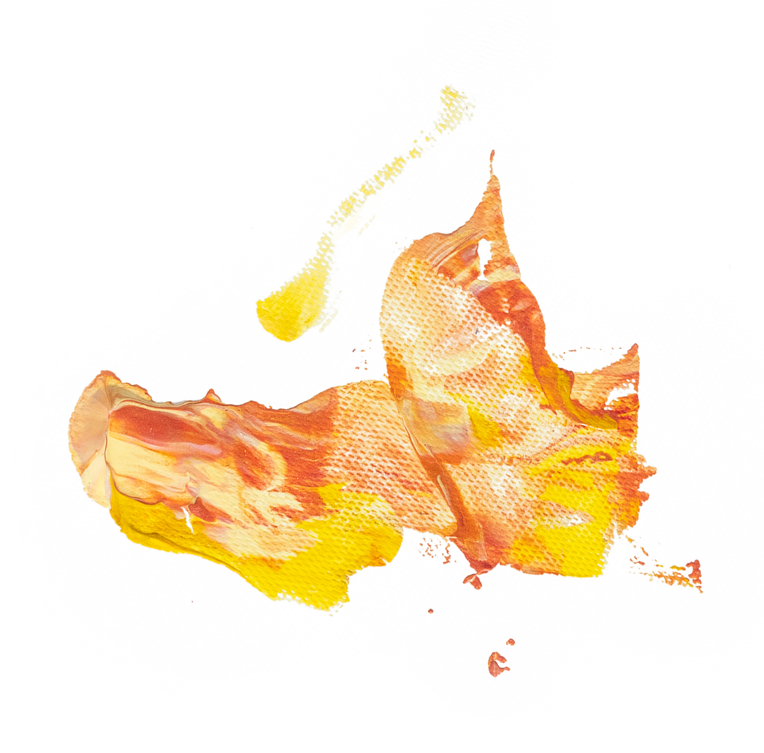
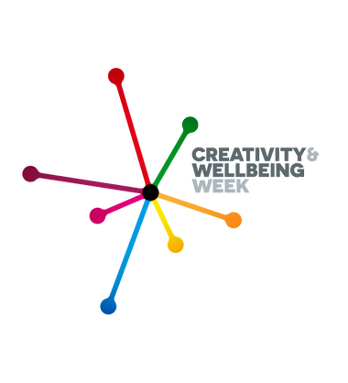
Creativity and Wellbeing Week
Monday 16 - Sunday 22 May

Slide 2
About the project
Creativity and Wellbeing Week is a national festival of events that takes place yearly. The week is hosted by London Arts and Health in partnership with the Culture, Health and Wellbeing Alliance.
The week aims to shine a light on the benefits of being creative on people's health and wellbeing, through public events, lectures, workshops and activities.
This year we hosted our first Creativity and Wellbeing Week. We worked alongside partners to hold professional opening and closing events, allowing colleagues from a range of organisations to learn and discuss how creative activities can be used within our communities. The week also provided us with an opportunity to promote and showcase creative and cultural activities taking place across the borough.
Key objectives of the week
Our key objectives of the week were to:
Outline the range of creativity and wellbeing evidence and insight demonstrating health and wellbeing benefits.
Explore leadership roles for creating a Barnsley creativity and wellbeing offer and a longer-term Cultural Strategy.
Summarise the role and achievements from key creative organisations, including the Culture, Health and Wellbeing Alliance.
Provide examples of local good practice with evidence of impact and social return on investment.
Identify next steps for wider engagement of leaders and key stakeholders across Barnsley.

Slide 3
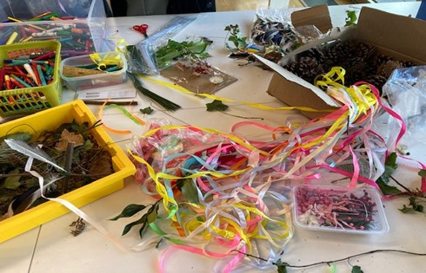
Opening event
Our opening event, on Monday, 16 May, aimed to start a conversation about how we build creative leadership across the system to embed creativity into health and care systems, planning and commissioning key services and programmes.
14 participants returned their post-event evaluation form. From those participants, all stated that the event broadened their knowledge and skills and helped them connect with others.
Take away thoughts:
"The value of creativity and the need to invest in it."
"The importance of creativity to wellbeing and the wealth of creativity in Barnsley."
"How creativity really can improve people’s wellbeing."
"It was really helpful for me to understand the level of cross sector commitment already in place across the MBC, and the volume of creative health work already happening in the area."

Slide 4
Creativity and Wellbeing Week activities
Working with our key partners, we developed a creativity and wellbeing programme providing access to a full range of creative activity opportunities across the borough during Creativity and Wellbeing Week.
Feedback from a selection of activities:
Glass works exhibition “Casting Characters” – 953 visitors to the venue, 272 visitors to the website.
Comments:
“Always wanted to see the Eric Morecambe statue and now I have it has really made my day”.
“It’s really cheered me up”.
“They should call it Hall of smiles as you can’t help but smile when you walk in”.
Discovery trail at Cannon Hall Museum, Park & Gardens - 266 visitors to the website
Comments:
"We love this trail with our children. Excitement at every turn."
"We started the trail and found that a monster was on the loose before going in search of it. There were little woodland activities along the route which the children loved. We also took our buckets with us to collect any natural treasures we could find along the way, it encouraged lots of talk about what we found and if it would fit in our buckets. #lovebeingoutdoors #natureplay #exploringnaturewithchildren #woodlandtrail."
Slazenger exhibition – 305 visitors during the week, 211 – visitors to the website
Comments:
"Really enjoyable exhibition."

Slide 5
Creativity and Wellbeing Week activities
Feedback from a selection of activities:
Wentworth Castle Gardens
A Mindful Walking event at Wentworth Castle Gardens took place on Wednesday 18 May. Seven participants took part, all of which were older people with physical and/or mental health needs. Comments:
“Perfect and peaceful. My mind feels at peace and calm. there should be more available. thank you.”
“For a person with a mind in turmoil. A worthwhile experience getting close to nature.”
“Calming. Brought me back to enjoyment of what is around me. So about being me.”
“A wonderful relaxing way to spend a morning in these beautiful gardens.”
Creative Recovery Sculpture Garden and Live Arts Café event
Over 50 people attended the afternoon event.
Comments:
“Brilliant and relaxing”
“Immensely enjoyable”
“Enchanting”
Sharing in togetherness”
“Uplifting and joyful”
“Immersive absorption, being present, like being at a festival”
“Uplifting and spiritual”
“A great enjoyable day!”
“Community connection”
“Grateful”
“Happy days!”

Slide 6
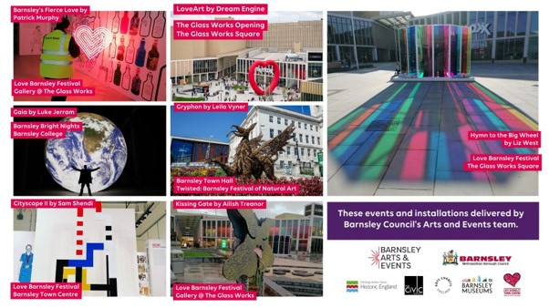
Creativity and wellbeing strategic workshop
We commissioned an online workshop which was held on Thursday, 19 May, to bring together key leaders across health, care and creativity organisations. The event attracted 23 participants from health and social care, VCS and creative organisations.
Seven participants returned their evaluation forms with everyone stating that the event fulfilled its purpose of providing knowledge, skills, and opportunities to collaborate and share ideas.
Take away thoughts:
"There is collective thought on how to progress and people are keen to collaborate."
"Create more time and space for convening; always think about how conversations are going to lead to change and communicating next steps/opportunities."
"People really care to make Barnsley a better place to live in. "
"How we can achieve so much more together."

Slide 7
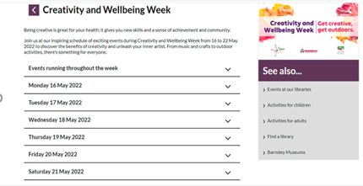
Communications
Social media
Internal communications
Social media was utilised to promote a range of activities as well as positive health messages relating to creativity under our Healthy Barnsley theme.
Four internal articles were shared in the run-up to the week of events. The articles received 125 unique page views in total. Articles were also shared in the bulletins linking to the webpage. In total there were 71 link clicks.
Facebook
Twitter
(total across eight posts)
(total across eight posts)
Website
Reactions: 107
Reactions: 33
A dedicated website was set up to host the events schedule. In total from April 21 to May 22, there were a total of 473 unique page views.
Organic Google searches and Facebook referrals were the highest source mediums for the page.
Comments: 18
Comments: 0
Shares: 59
Shares: 39
Reach: 16,752
Reach: 11,722
Engagement: 755
Media coverage
The week of events was covered in the media by:
Barnsley Chronicle
BBC Radio Sheffield
The Culture, Health and Wellbeing Alliance
Around Town magazine - 'what's on' advertisement
News Anyway
Hoyland CAP local community news

Slide 8
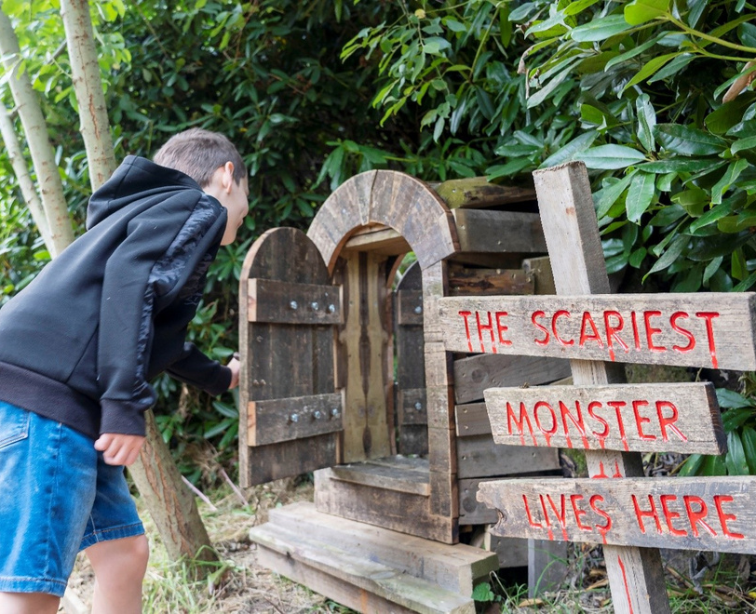
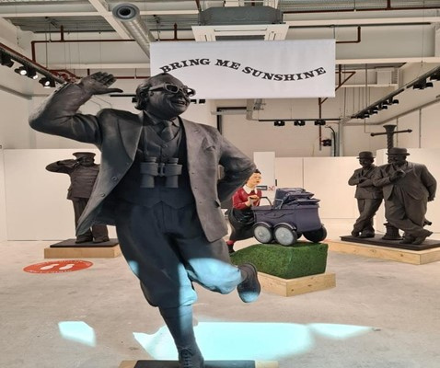
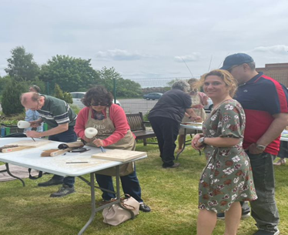
Recommendations and next steps
Disseminate this report outlining participants' insight and feedback of Creativity and Wellbeing Week widely to leaders across the system.
Seek endorsement from Health and Wellbeing Board, Integrated Care Board and other leaders involved in key strategic boards to invest and scale up efforts to embed creativity and wellbeing into system leadership
Draw out the themes from the activities to contribute to the development of the citizen-led Barnsley Cultural Strategy
Create a plan on a page and full programme plan, co-produced with key partners.

