Slide 1
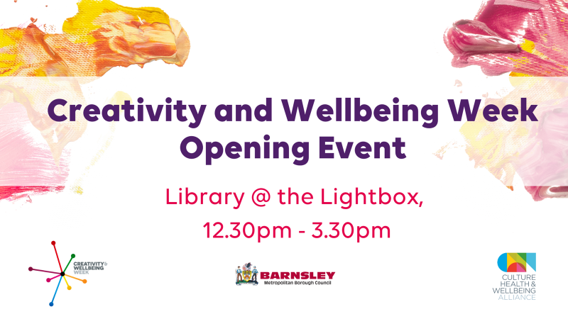
Creativity and Wellbeing Week Opening Event

Slide 2
The Art of Healing
Matt Walsh
Barnsley May 2022

Slide 3

We only have 5 things
Words
Relationships
Courage
Willingness to love
Choices and what we learn from making them

Slide 4
Adebowale’s 4 tests;
I will know that you have engaged with me because you will have changed because you have engaged with me.
Change
Power
I will be able to do more, because you have engaged with me. I will have more power
Feel
I will know that I am at the heart of your thinking because I will be able to feel it.
I know about the quality of my experience. You will want to understand my experience. You will actively seek my views about quality.
Seek

Slide 5
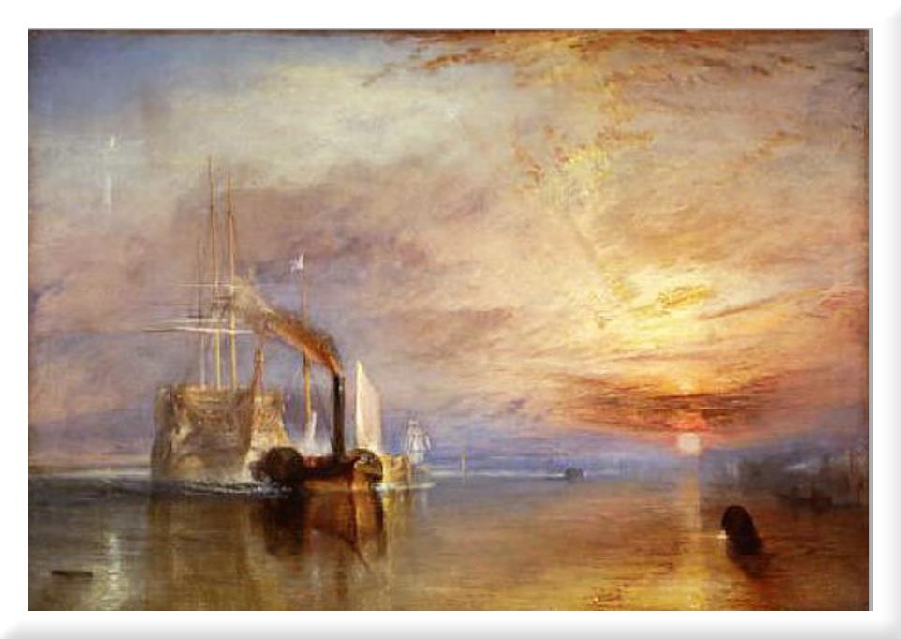
Famous Art

Slide 6
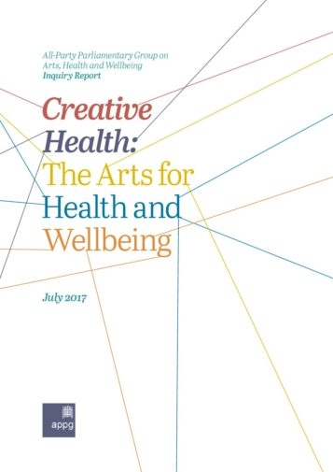
APPG Report 2017

Slide 7
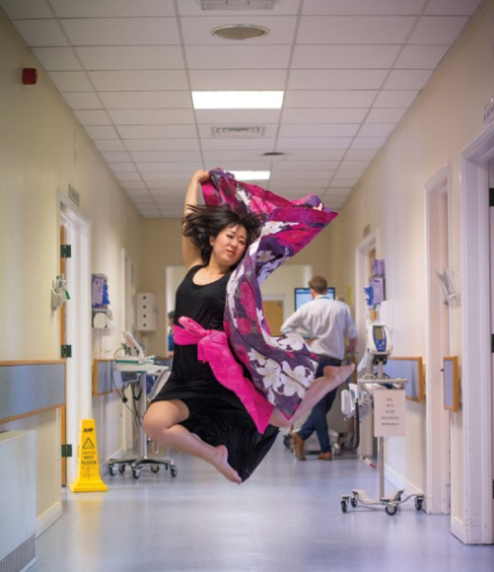

Creative Health

Slide 8
Elevation in ballet

Slide 9
Why is creativity important?

Slide 10
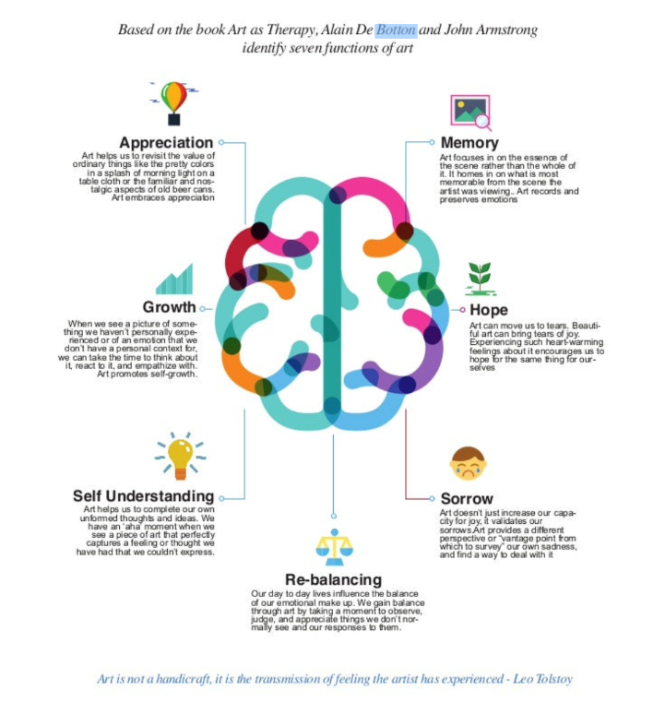

What does it do?
Caption

Slide 11
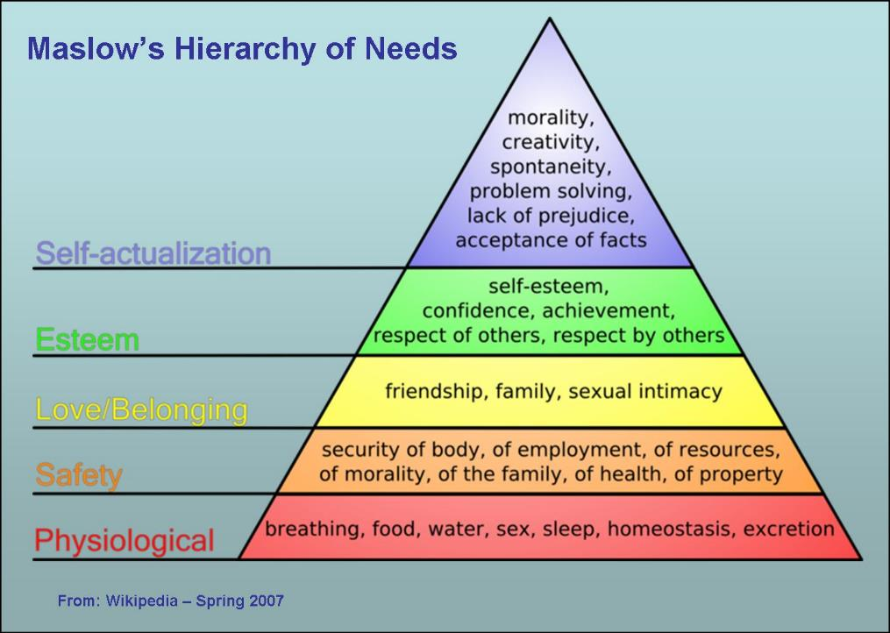
Maslow’s Hierarchy of Needs

Slide 12
Maslow’s Motivation Model

Slide 13
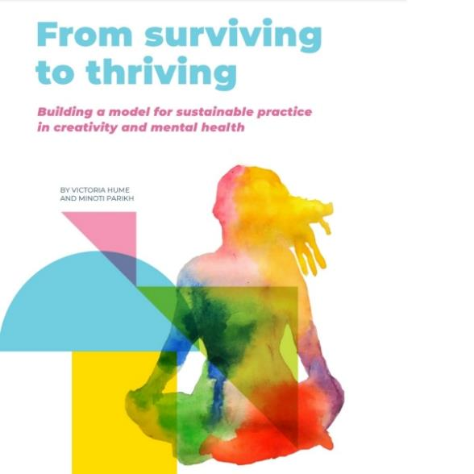
From Surviving to Thriving

Slide 14
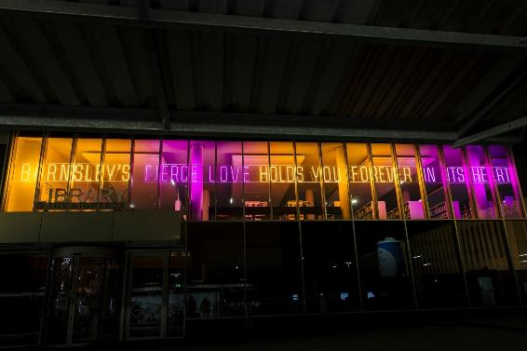
Barnsley

Slide 15
Questions and Challenges
If individual and collective creativity is the engine which drives us up to the pinnacle of Maslow’s pyramid, how should we ‘value’ it? How much is it worth?
If Creative Energy is the fuel, how can we ensure that we have enough?
If the evidence that inviting participation in creativity reduces costs in health and care, how much resource is being invested in Creativity by organisations delivering health and care?
How can we ensure that access to creative opportunity is voluntary and does not depend upon ‘referral’ and does not operate as a ‘medical’ model?

Slide 16
Skylark - Matt Walsh
Happy heart
Your music fills the northern sky
Sing across the sun
Shout your joyous song
Remind us all that life's worth living.
Bright dark sky,
Trill your thrilling tune, quiver
Wings and hover,
Descend almost
And lead us all a merry dance.
Stay and sing
Little bird, colourful with song
Pull my heartstrings tight
You blind me
Your music stops me.

Slide 17
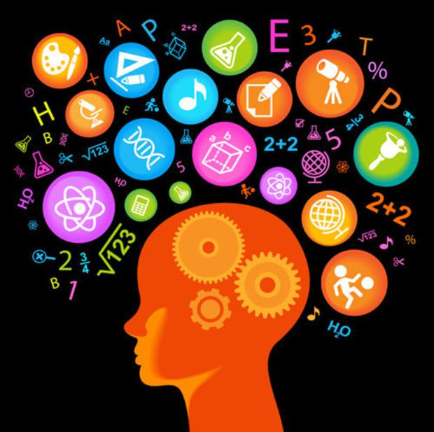
Culture, Health and Wellbeing:
The role of leadership
Wendy Lowder, Executive Director Adults and Communities, BMBC
Kathy McArdle, Service Director Regeneration and Culture, BMBC

Slide 18

Recipe for leadership in this set of interlocking systems - arts, culture, health, adult/social care
Ingredients:
2 oz Research / impact analysis
3 tbps of being curious
10 teaspoons of being caring
40 pints of listening
4 ml of developing next practice
A dollop of compelling storytelling (with an edge)
½ litre of empowering people
Oodles of compassion, care, commitment
½ litre of empowering people
Method:
Be outcomes focussed
Create simplicity where complexity exists
Act as a Collaborator &
convenor of conversations
Connect – people, ideas, organisations,
Systems
Work across current boundaries
Be interdisciplinary
Live and breath being an advocate

Slide 19
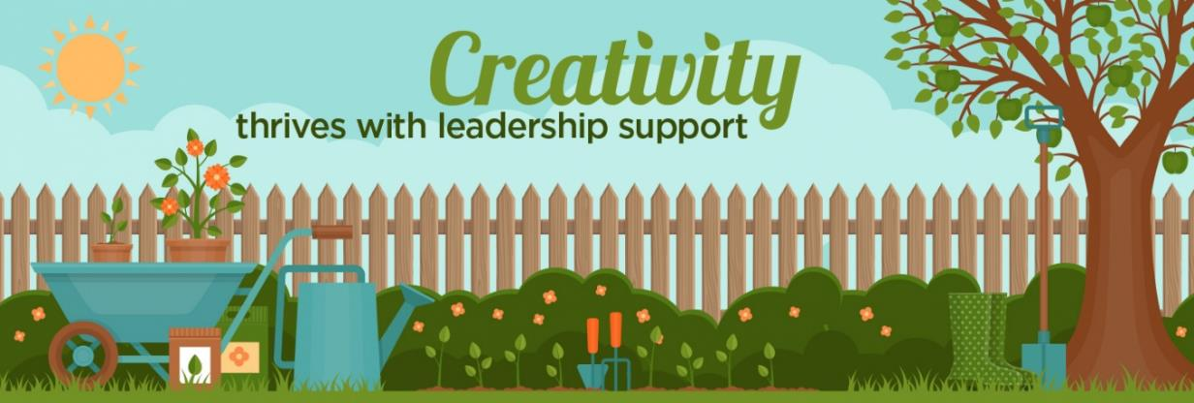
Stories of Culture, health and wellbeing leadership

Slide 20
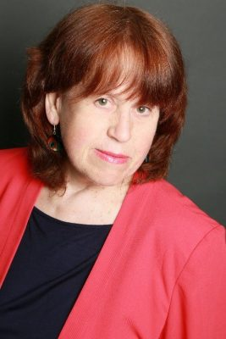
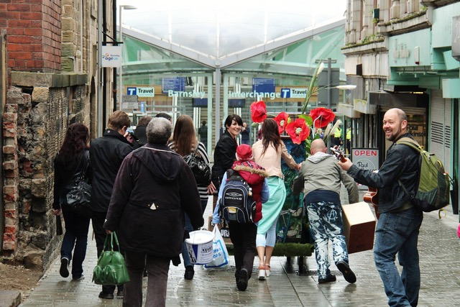
Hayley Youell, Creative Recovery and Arts, health and Wellbeing Alliance (based in Barnsley) - https://hayleyyouell.com/social-change/
Gerri Moriarty (Northern Ireland, Greater Manchester, UK) - http://gerrimoriarty.com.websitebuilder.prositehosting.co.uk/live-well-make-art

Slide 21
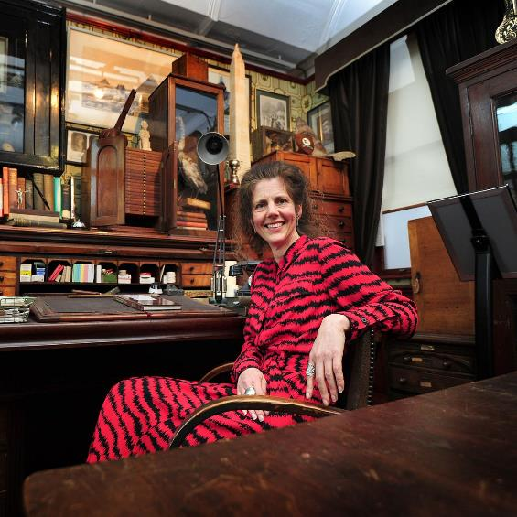
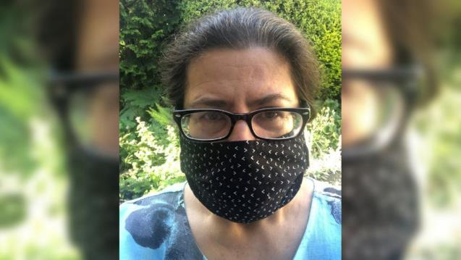
Meet the team.
Esme Ward (Greater Manchester) - https://www.culturehealthandwellbeing.org.uk/news/day-life/day-life-esme-ward
Julia Burrows (Barnsley) - https://barnsleymbc.moderngov.co.uk/documents/s77939/Appendix%20B.pdf

Slide 22
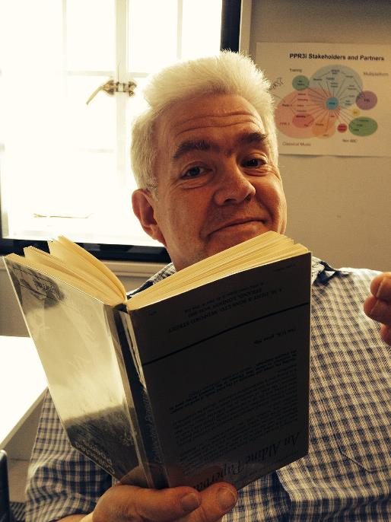
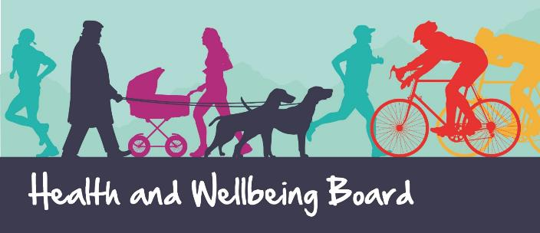
Meet the team
Ian Mc Millan (Barnsley) - https://wearedarts.org.uk/blog-ian-mcmillan-on-working-with-darts/ and https://podtail.com/no/podcast/well-i-know-now/ian-mcmillan-tony-husband-ian-beesley/ and https://theunfurlings.org.uk/
Health and wellbeing board, good example of collective leadership (Barnsley) - https://www.barnsley.gov.uk/media/19957/barnsley-hwb-strategy-final-web.pdf

Slide 23
Leaders at every level.
Leaders at Every Level
Freelance artists
Care Home staff
Participants / patients
GPs
Local authority officers
NHS executive team
What are you already doing to bring culture and health together for better outcomes?
What else could you do?
What could you do to support other leaders ?
NHS staff
Clinicians
Carers
Families
Funders
Policymakers
Nurses
Artistic Directors
Doctors
Commissioners
Councillors

Slide 24


Creative Health:
From Surviving to Thriving
Victoria Hume
Culture, Health & Wellbeing Alliance
culturehealthandwellbeing.org.uk
@CHWAlliance

Slide 25
Case studies during lockdown
Creative health programmes for people shielding at home
…or in institutions
Case studies available here
50 organisations, 100,000 people reached
Phone / post / online
Tackling variety of health conditions, overwhelmingly addressing loneliness and isolation
94% in partnership
  69% with other community organisations
  50% with Local Authorities (31% received funding from LAs)
  48% in partnership with the NHS (15.5% received funding from NHS)
  60% supported by National Lottery distributors
  53% supported by Trusts & Foundations
Case studies available here
47 case studies, appx 50,000 people reached
Online / pre-recorded / live performance / radio / activity packs etc.
Designed to improve wellbeing (inc. staff), loneliness or isolation, supporting social or family connections, meaningful activity, skills development, challenging boredom, and build participants’ confidence.
72% in partnership
  35% with community sector organisations
  26% with the NHS
  24% with (other) arts and cultural organisations
  16% with the care sector
Notes:
Theatre Orchard worked with 20,000+ vulnerable adults, older people, vulnerable families and hospital in-patients with an online festival, events, workshops and printable resources during the first lockdown. They were about tackling loneliness, and supporting mental health, skills development, family activity, self-expression, and peer support. I’ve included this quote because it illustrates the fact that creative work isn’t just about doing something nice to make us feel better in the moment, it’s also a way of catalysing engagement with local authorities and helping to shape priorities.

Slide 26
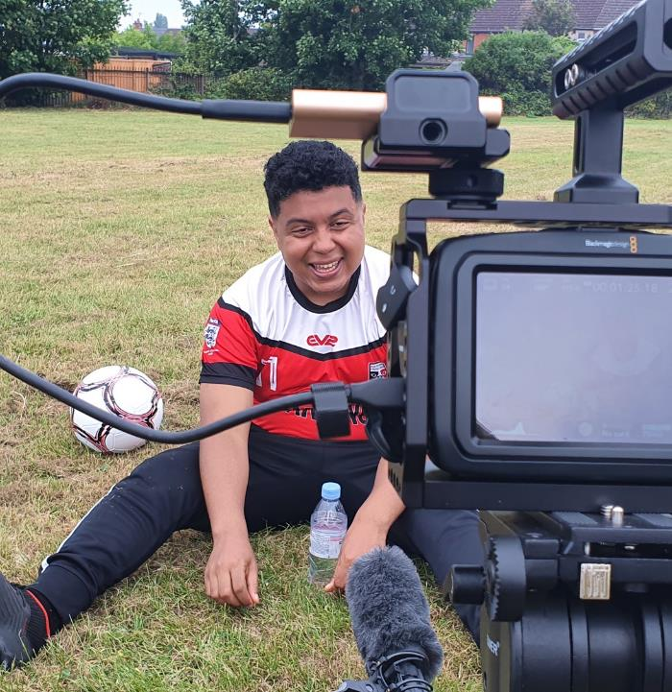
Red Earth Collective (Birmingham)
“The Red Earth Collective uses the arts to inspire stories, stimulate thinking and to create conversations that support and improve the mental health and wellbeing of marginalised and racialised communities.”
https://www.redearthcollective.org.uk
Image: The Red Earth Collective Menologues, 2020

Slide 27
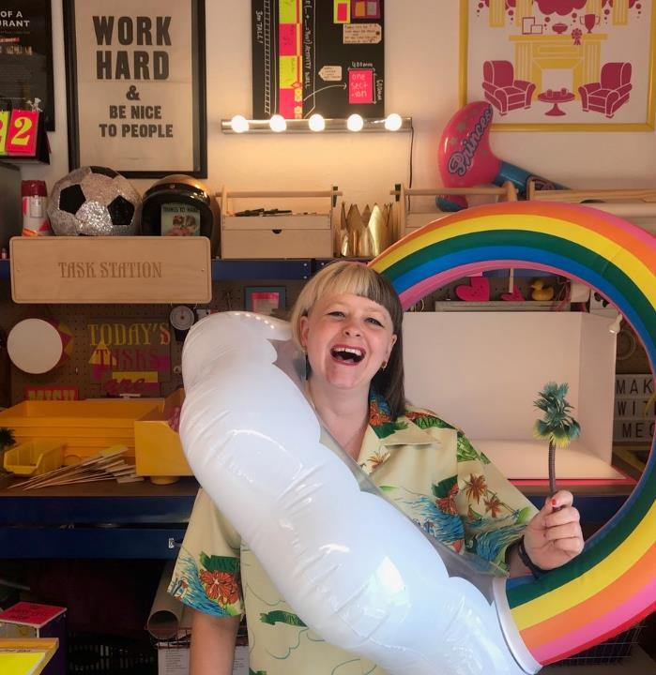
Theatre Orchard (Somerset)
“I feel so valued and I want more people to experience this. We need resources, we have the family we just need a home to out us all in! I want Theatre Orchard to be a “forever”. I want my grand-babies to experience what I have experienced because I know that they might need a safe space too.”
https://www.theatreorchard.org.uk/

Slide 28
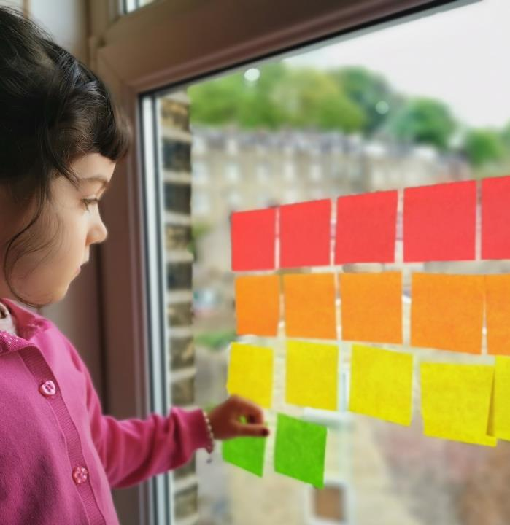
Creative Learning Guild (Calderdale)
clinician-approved creative activity packs using arts and culture to boost wellbeing for children and young people identified by the local authority as the most vulnerable
https://artsdrop.co.uk/

Slide 29
Evidence
You can link to all the evidence from
https://www.culturehealthandwellbeing.org.uk/resources/research-and-evaluation
DCMS Evidence Summary for Policy: The role of the arts in improving health and wellbeing (Fancourt, Warren & Aughterson, September 2020)
World Health Organization Synthesis Report (Fancourt & Finn, 2019)
Creative Health: The Arts for Health & Wellbeing (All-Party Parliamentary Group for Arts, Health & Wellbeing, 2017)
Arts and culture in health and wellbeing and in the criminal justice system: a summary of evidence (Arts Council England, 2018)
Heritage and Wellbeing: The State of the Evidence (What Works Centre for Wellbeing, 2019)
Museums as Spaces for Wellbeing: A Second Report (National Alliance for Museums, Health and Wellbeing, 2018)

Slide 30
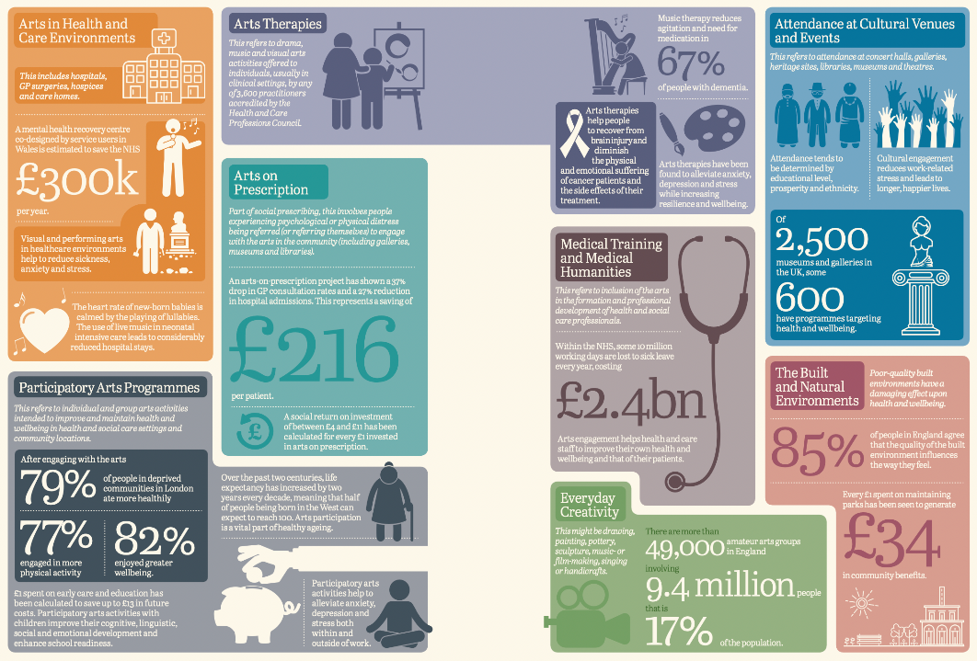
Infographic from the Creative Health report from the APPG for Arts, Health & Wellbeing
Notes:
Infographic from the Creative Health report from the APPG for Arts, Health & Wellbeing

Slide 31
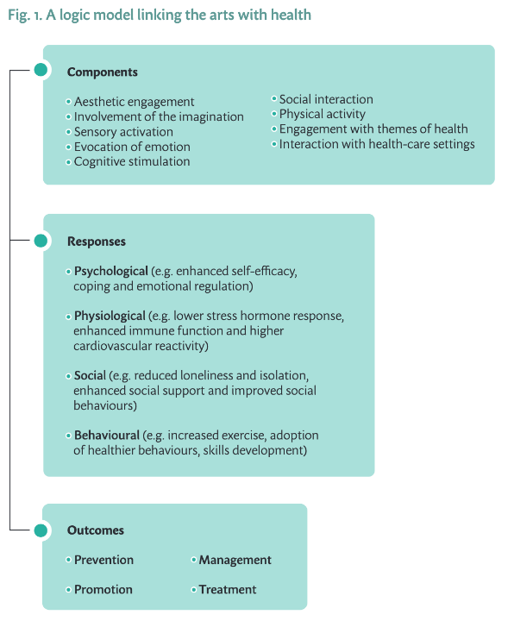
World Health Organization Synthesis Report (2019)
Notes:
A useful logic model from the 2019 report, which was based on over 9,000 peer reviewed studies across Europe and Russia

Slide 32
DCMS Evidence Summary (2020)
“strong ‘grade A’ evidence for the following outcomes … evidence can be trusted to guide policy”
  The use of music to support infant social development
  The use of book reading to support child social development
  The use of music or reading for speech and language development amongst infants and children
  The use of the arts to support aspects of social cohesion
  The use of the arts to improve wellbeing (i.e. positive psychological factors) in adults
  The use of the arts to reduce physical decline in older age
Notes:
“promising ‘grade B’ evidence for the following outcomes … evidence can be trusted
to guide policy in most situations”
The use of the arts (other than reading) to support child social development
The use of the arts to support wellbeing in children and young people
The use of the arts to support cognition in older age
“weaker ‘grade C and D’ evidence
The use of the arts to reduce social inequalities
The use of the arts to improve educational attainment
The use of the arts to manage or treat mental illness (e.g. depression and anxiety) in children and young people
The use of the arts to prevent mental illness (e.g. depression and anxiety) in adults
The use of the arts to prevent further cognitive decline in adults with cognitive impairments
The use of the arts to reduce non-communicable disease incidence

Slide 33
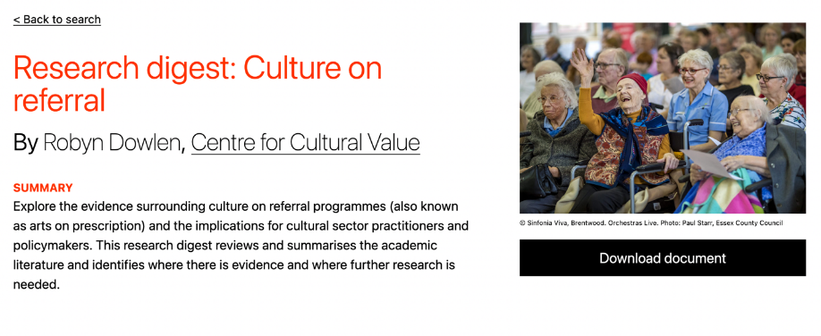
Centre for Cultural Value (Leeds)
https://www.culturehive.co.uk/CVIresources/culture-on-referral-research-digest/
Notes:
The CCV at Leeds University is a vitally important body when it comes to research in this area; they have produced three research digests and are steering the agenda towards equity and putting practitioners back into research.
Other research digests look at young people’s mental health (https://www.culturehive.co.uk/CVIresources/research-digest-young-peoples-mental-health/) and Training and development of healthcare students.
The Culture on referral digest concludes that “Although all the studies demonstrated positive outcomes relating to wellbeing for participants taking
part in culture on referral programmes, there is still significant progress that needs to be made within this research area to be able to create a stronger evidence base.”

Slide 34
Latest research
Arts and Humanities Research Council, Natural Environment Research Council, Medical Research Council programme exploring how community assets are supporting the levelling up agenda and how they can develop more sustainable partnerships with health.
12 pilot projects across the UK covering a diverse range of programmes and partnerships from wild swimming to arts for young people, with more funding for the next phase to be announced imminently.
For more info: https://www.ukri.org/news/investment-in-culture-and-nature-to-boost-the-nations-health/
Notes:
In response to the DCMS summary’s acknowledgement of a relative lack of evidence around health inequalities there is increasing research being directed in this area; and additional funding for this work coming in from UKRI

Slide 35
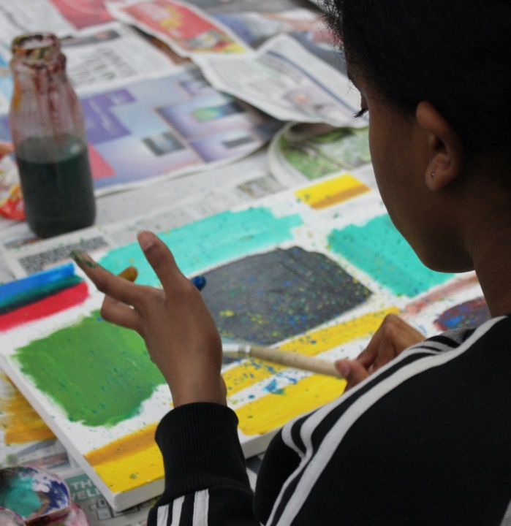

From surviving to thriving
Building a model for sustainable practice in creativity and mental health
https://www.culturehealthandwellbeing.org.uk/surviving-thriving-building-model-sustainable-practice-creativity-and-mental-health
Mental Health The Arts
Notes:
This year we have been working with practitioners specializing in supporting mental health with the arts to understand what needs to happen to make their work more stable and sustainable. This has resulted in a series of recommendations for funders, researchers, commissioners, practitioners and infrastructure organisations like CHWA.
The commissioner and funder recommendations may well be useful to this group and will be shared in late January.

Slide 36
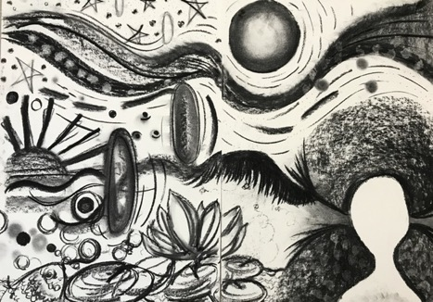
Survey
Context
65% freelancers, 20% employed at least part-time by an arts org.
9% employed by health organisations, 4% by local authorities.
Almost 40% work in this area because of their own experience of creative practice supporting mental health; 32% came to it through other arts work (education / community arts);
3% through higher ed / postgrad
96% use creative practice to support their own mental health.
Image: Green Close

Slide 37
Survey
What challenges do you face working with creativity and mental health? /
What needs to change to make your work easier?
Funding, credibility/reputation, resilience, better partnership
What helps you to carry on?
Seeing the impact on others, belief/passion
77% working with creativity and mental health for 5 years or more;
44% for 15 years or more.

Slide 38
Creativity and Culture supporting mental health.

Slide 39
Some local authority initiatives
Arts on Prescription Gloucestershire:
37% drop in GP consultation rates;
27% reduction in hospital admissions.
Social return on investment of £4–£11 for every £1 invested
Greater Manchester Combined Authority:
A Social Glue (2020) https://www.youtube.com/watch?v=LaOETwURWz4
Greater London Authority
Cornwall Creative, Health & Wellbeing Partnership
NCCH ‘Hubs’: https://ncch.org.uk/what
  Working with ICSs in Gloucestershire; West Yorkshire and Harrogate; Shropshire, Telford and Wrekin; and Suffolk and North East Essex to explore models for integrating creative health at a systems level – supported by NHS England.
  Toolkits to be published early 2022.
Brighton & Hove Public Health Report
Northumberland Council Cultural Strategy ‘Our Creative Landscape’ & 2019 Director of Public Health Annual Report focussed on creative health
Notes:
There are examples around the country of a more embedded approach to culture, health and wellbeing: in Gloucestershire, long-term investment by the Clinical Commissioning Group has led to significant falls in GP consultation rates and hospital admissions. In Cornwall, the Council’s Culture and Public Health teams have developed a Creative, Health and Wellbeing Partnership for Cornwall and Isles of Scilly, launched in 2020 with a particular focus on addressing health inequalities, improving mental wellbeing and addressing loneliness and isolation. In 2020, Greater Manchester Combined Authority launched A Social Glue from the Manchester Institute for Arts, Health & Social Change, aligning culture with Manchester’s commitments to building a fairer, more equal society as the UK’s first Marmot city-region.

Slide 40
Briefing for Integrated Care System planning
Briefing from APPG for Arts, Health & Wellbeing and Culture, Health & Wellbeing Alliance and Kent Surrey Sussex Academic Health Science Network “to support and inspire planners to include the arts and culture in their vision for the transformation of care with case studies from One Gloucestershire and West Yorkshire and Harrogate Health and Care Partnership.”
Download the briefing here

Slide 41
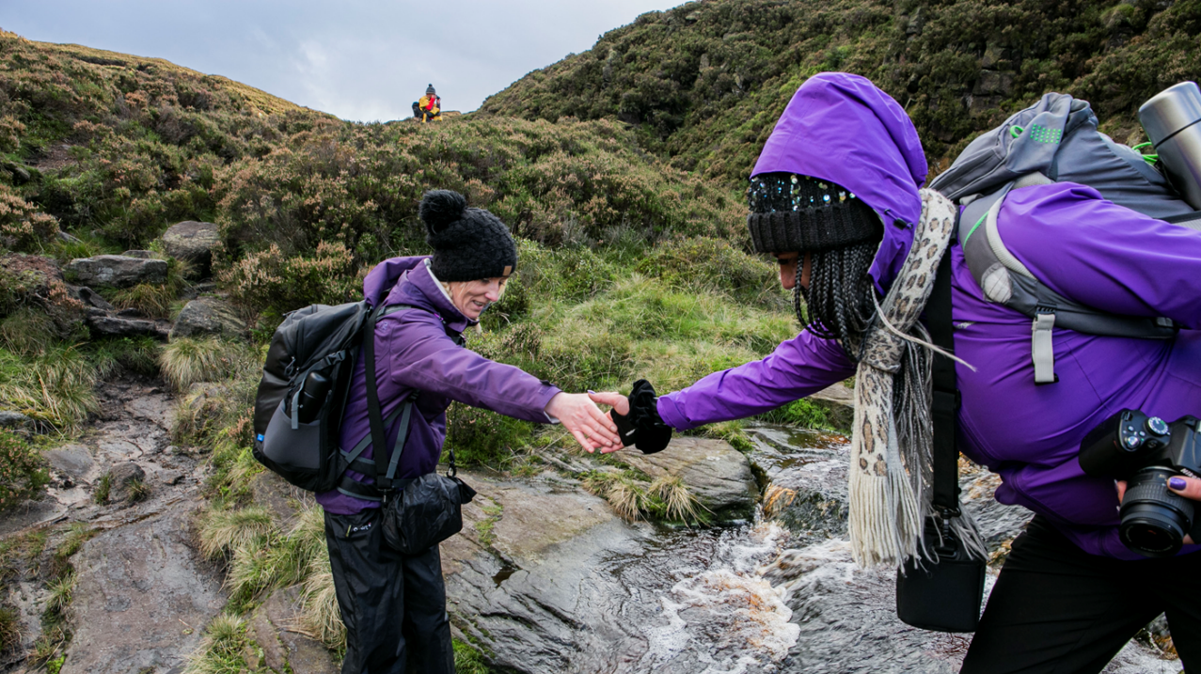
Creativity and Change: how creativity can help drive change across the health and care system

Slide 42
Creativity & Health Calderdale
Steering Group Partners and Funders
South West Yorkshire Partnership Foundation Trust
Calderdale CCG
North Halifax Primary Care Network
Calderdale MBC
Arts Council England

Slide 43
Investment
Project started with £90k of system/ Arts Council investment.
Recap of funding to date – this takes funds raised by the Creativity and Health Programme to £848,000.
System |  | Non-System
SWYPFT (projects) | £166,000 | Arts Council | £95,000
Locala | £80,000 | Youth Music (Fund A) | £27,000
Calderdale CCG | £80,000 | Community Foundation for Calderdale | £15,000
CMBC | £50,000 | CAF (Charities Aid Foundation) | £106,000
SWYPFT | £80,000 | Youth Music (Band B) | £92,000
North Halifax PCN | £10,000 | NHS Charities Together | £15,000
NHS England (specific project) | £32,000
Total | £498,000 | Total | £350,000
 |  | Overall Total | £848,000

Slide 44

Living a Larger Life
Everyone achieving their potential

Slide 45
Our vision:
That arts, culture and creativity are embraced by our citizens in their everyday lives and incorporated into health sector approaches results in longer lives better lived and stronger, more connected communities.

Slide 46
Creativity and Population Health
Tier 2
Targeted Interventions to address health inequalities
Tier 4
Sustainable Change in Provision
Tier 3
Arts as a tool for system change
Tier 1

Slide 47
Arts as a tool for system change
Tier 1
In the health sector, what might be improved by taking a new and creative approach? What decisions can we involve artists and service users in Are there positive outcomes for the health and wellbeing of our own workforce?
In the cultural sector, what change is needed for the arts to be a system of universal access?

Slide 48
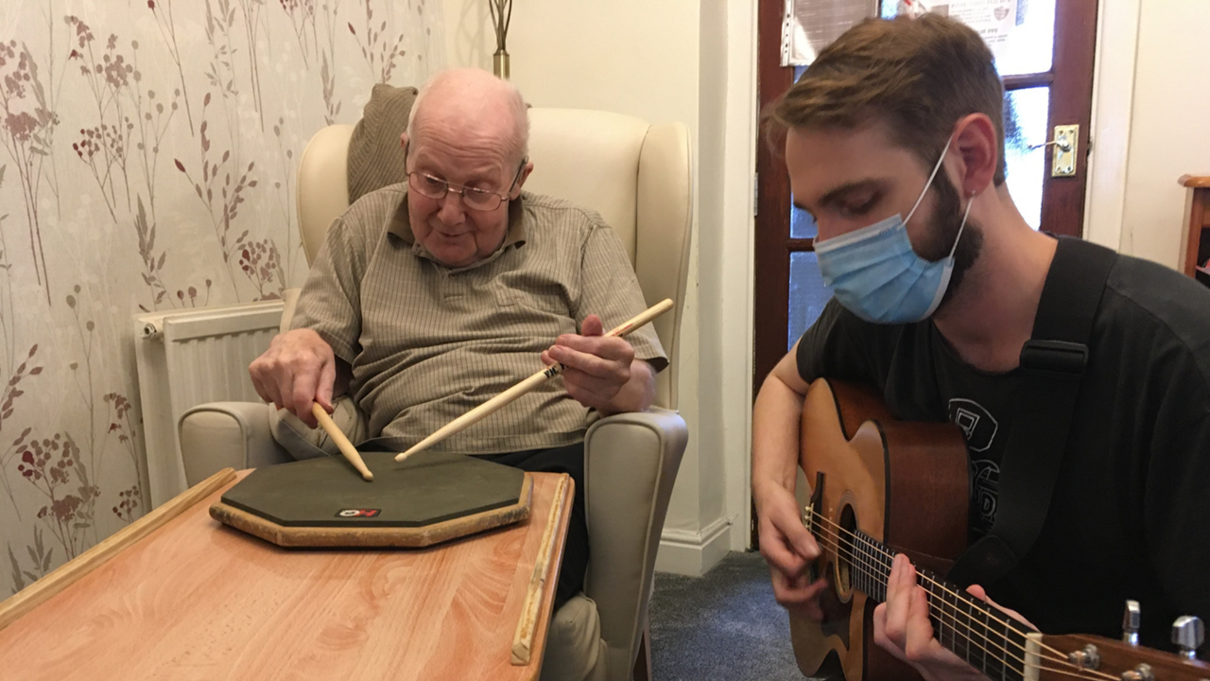
Music in Care

Slide 49
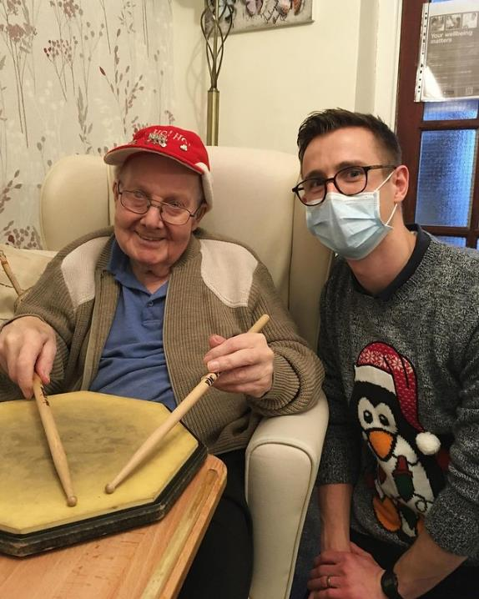
Music in Care
During the first session of ‘Music in Care’, the drummer noticed one man staring at his hands and wondered if he had played drums before so took in sticks and pad the following week.
“After 8 weeks of having the privilege of working with the residents of two wonderful care homes in Yorkshire, myself and Harry Orme had our last day today.
Norman’s face has always lit up when we have arrived and he tapped along through all of our sessions. As today was our last day I managed to find my first ever practice pad in the loft, and along with a pair of sticks we were able to leave Norman with the ability to keep on drumming after we had left. Needless to say he was pretty chuffed…fingers crossed the carers don’t confiscate it if he never stops shredding!”
Tom (Musician) and Norman (Resident)

Slide 50
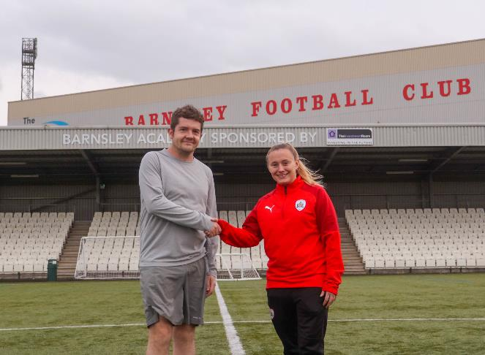
Safety Nets
A new scheme to bridge the gap between being referred and receiving treatment is proving really helpful for young people in South and West Yorkshire.
Participants in the ‘safety net’ programme have showed an average improvement of 39% in the Warwick Edinburgh Short Scale which measures mental wellbeing.
Dave Watson, Project Development Worker for Creative Minds, said: “We’re delighted to be supporting this valuable work which is popular with both young people, the sports clubs and CAMHS professionals. We’re planning to expand the scheme across our Trust area and get more of our teams involved.”

Slide 51
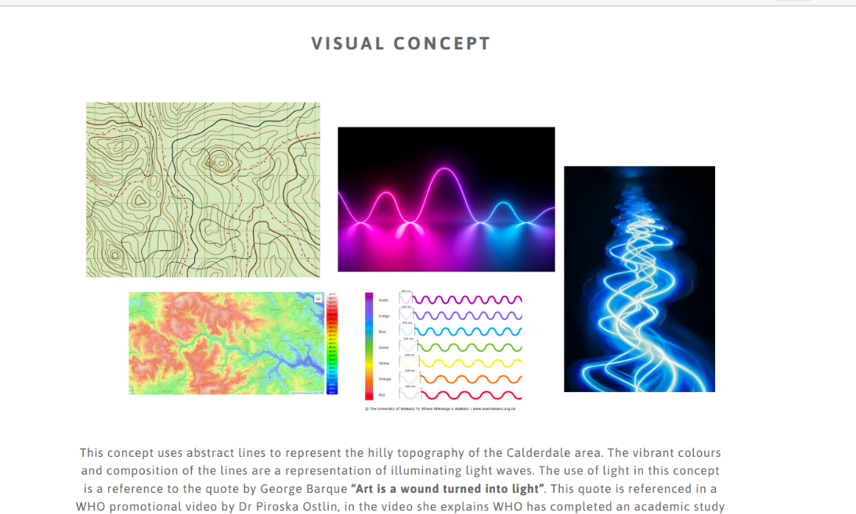
Creativity App

Slide 52
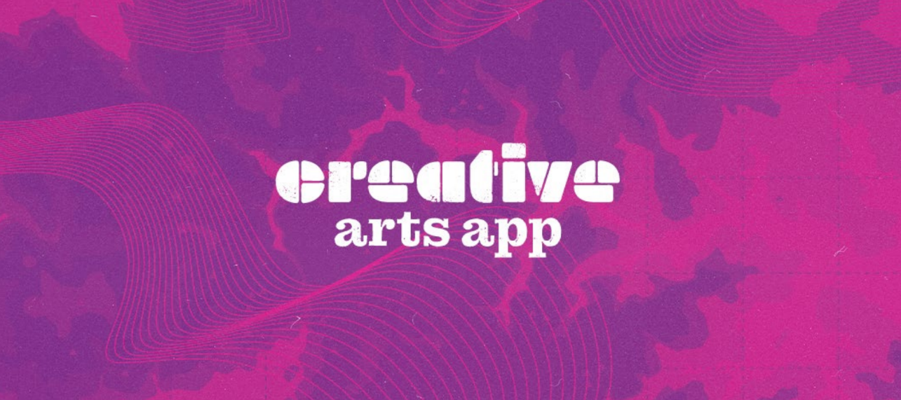
Creative Arts App.

Slide 53
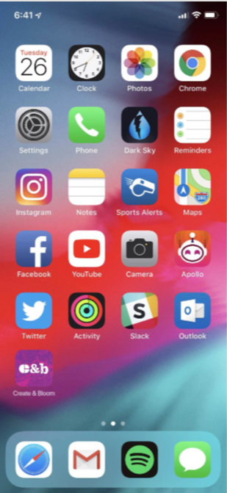
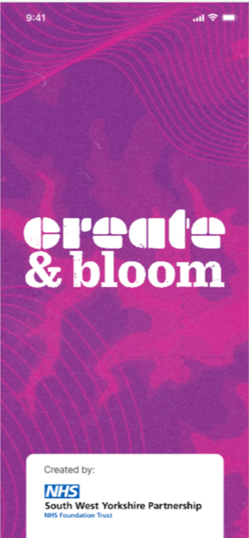
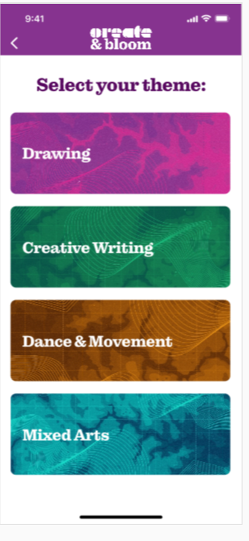
Create & bloom App

Slide 54
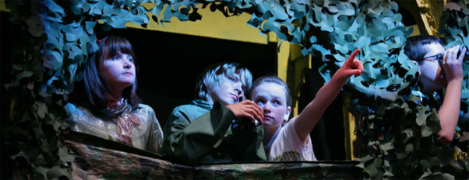
Heartbeats
Music Making in Children’s Wards with CHFT: twin focus on early years and CAMHS
“Working with children and young people, the hospital youth forum, parents, staff, carers, artists and musicians, we will co-produce an innovative approach to providing music making opportunities for children and young people (that will also face additional barriers to taking part outside of hospital) that works with current infection control and will enhance the care, recovery and engagement of young people engaged with our healthcare system.”
In Partnership with Calderdale and Huddersfield Foundation Trust and Theatre Company Blah Blah Blah, Creative Minds have been awarded £92,000 from Youth Music to develop new music making infrastructure that can be installed in individual rooms on children’s wards in Calderdale and Huddersfield hospitals.

Slide 55
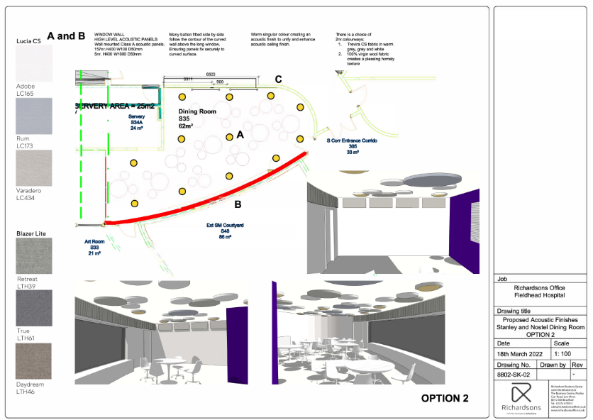
SWYPFT Dining Room and Ward Spaces

Slide 56
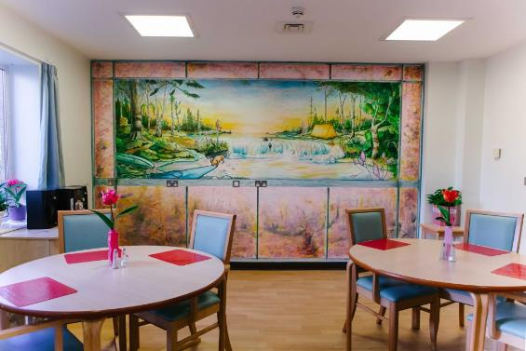
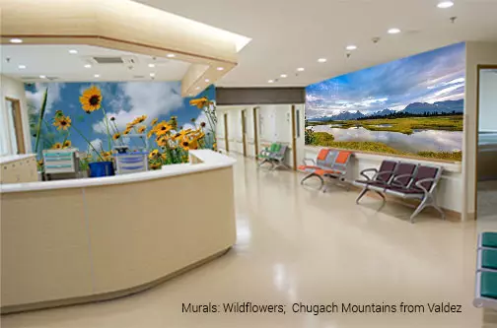
How do we visually transform the space?

Slide 57
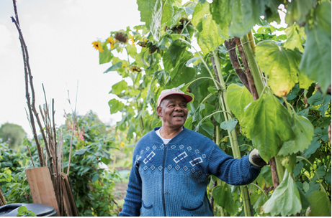
Sunflowers

Slide 58
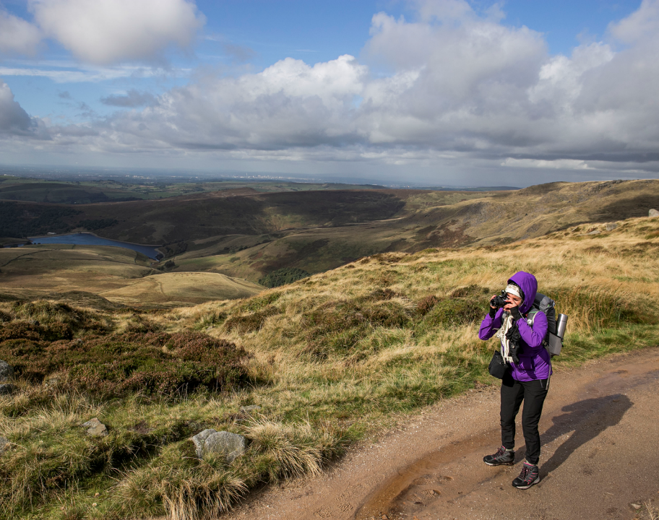
resonant meaningful local landscapes

Slide 59
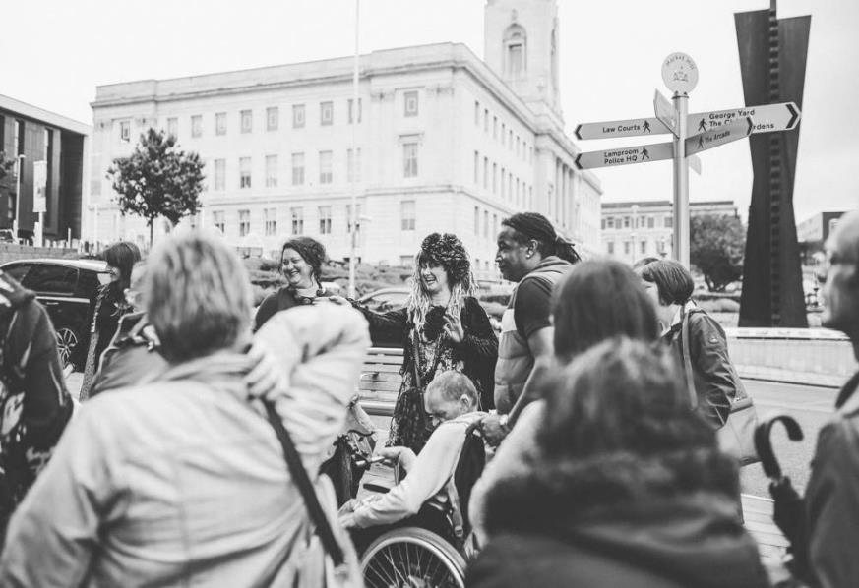
Creative Recovery:
People Power and Co-creating Pathways

Slide 60
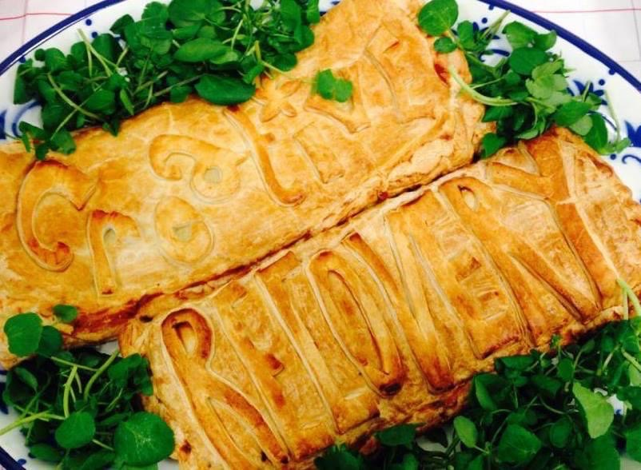
Creative Recovery

Slide 61
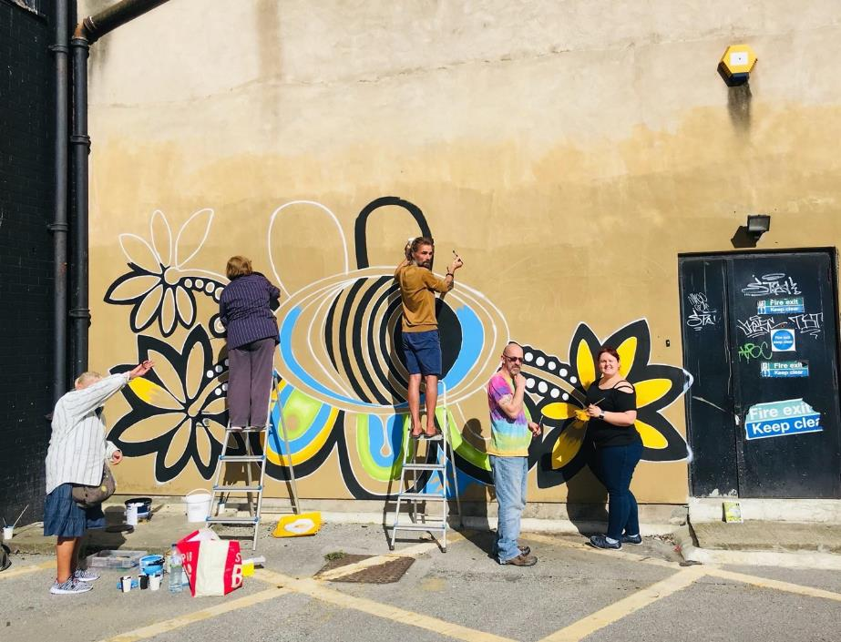
We are…
People-led
Creative
Collaborators

Slide 62
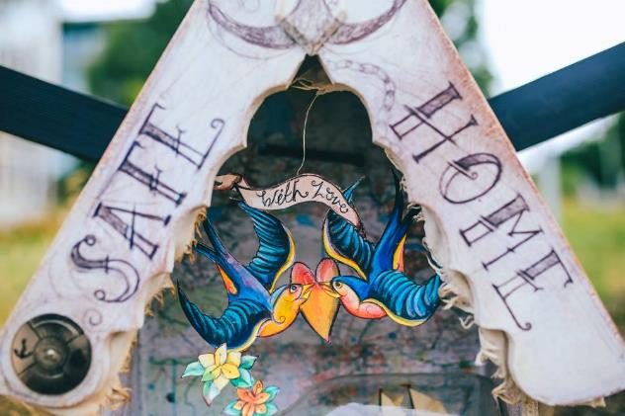
Our Core
MON & TUES: ‘Open Studio Days’ at Temperance House
WED: Reading Together (in partnership with Barnsley Libraries)
WED (eve): The Live Arts Cafe
THURS: UPLIFT Choir @ St Paul’s
FRI: Walking/ Allotment Groups
Acute mental health and criminal justice settings work partnership with SWYFT and Creative Minds:
MON: Criminal Justice settings- Wetherby HMP/YOI
WED: Kendray Hospital

Slide 63
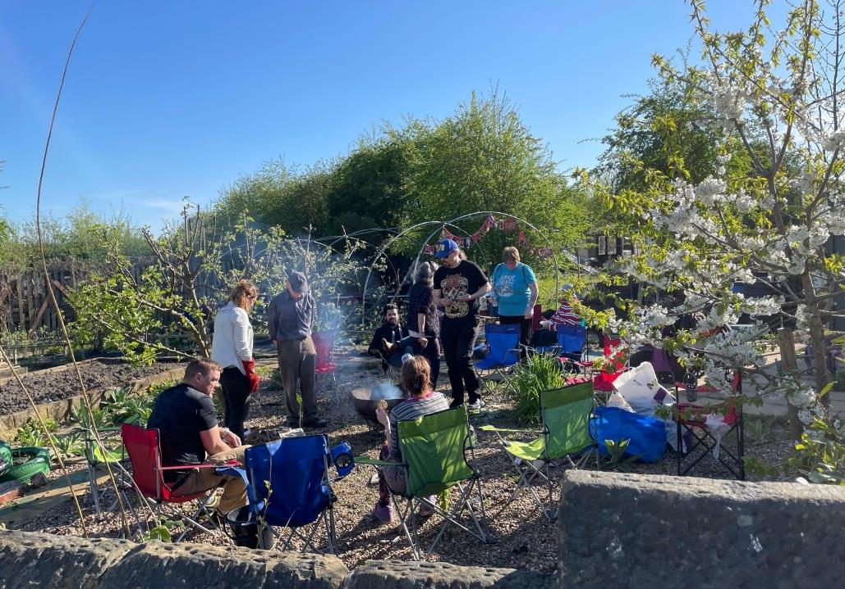
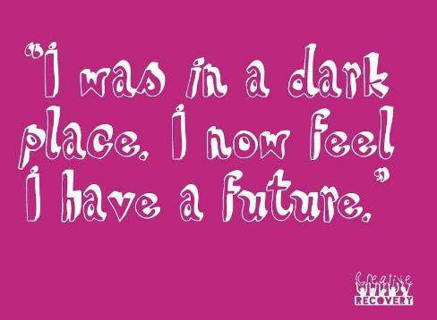
Allotment group.

Slide 64
Social Return on
Investment:
ARTS on Referral Programme
£1:£7
For every £1 invested in the The AOR programme delivered £7 in social capital.
Key Outcomes:
  83% of participants reported increased psychological resilience alongside improved social connectedness, general mental wellbeing, motivation and coping skills
  Reduced access to acute mental health services, GP visits and medication
  Improved access to the cultural offer and increased footfall to venues
Shortlisted for the ‘Most Innovative Mental Health Service’ in The Positive Practice in Mental Health Awards 2013

Slide 65
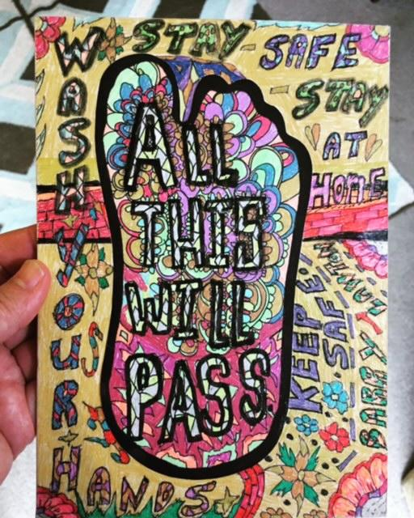
Image: Artwork from the Mail Art project
“ Shielding was difficult. The phone calls helped me feel connected to a group of friends.
Sharing happy memories of past times and the thought of seeing everyone in the future was the main thing that kept me going through the dark times”

Slide 66

Things To Live For
Building Connection- New support networks and shared experiences
Finding Purpose and Inspiration
Therapy with a small ‘t’. Strategies for coping with overwhelming emotions, and enabling reflection, relaxation, self-expression etc

Slide 67
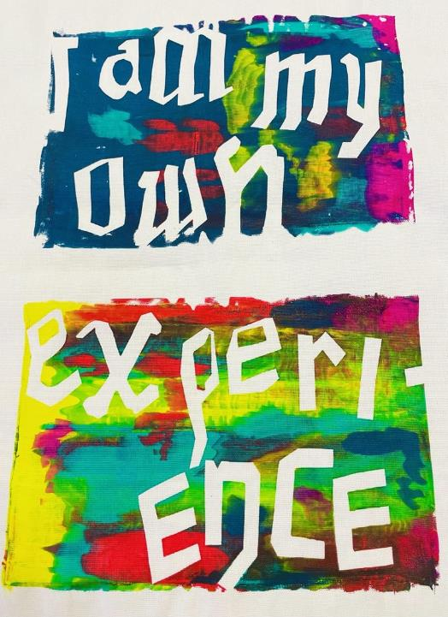
“ It’s enabled me to be more aware and regulate my emotions, which in turn regulates my self-harming”
“ I’m feeling more confident to talk about stuff and express myself more. Helped to manage stress levels and has helped me to sleep better”
Image: Participant’s screen print, Things to Live For, 2021

Slide 68




Green UPLIFT
“ UPLIFT has transformed my life- for the better. Before I was socially isolated and had no channel for my creative side. UPLIFT activities have been rewarding in their own right but have also enlarged my social network. I count several people I have met as my friends now.”
This project is supported by South Yorkshire Community Foundation and South Yorkshire and Bassetlaw Integrated Care System

Slide 69
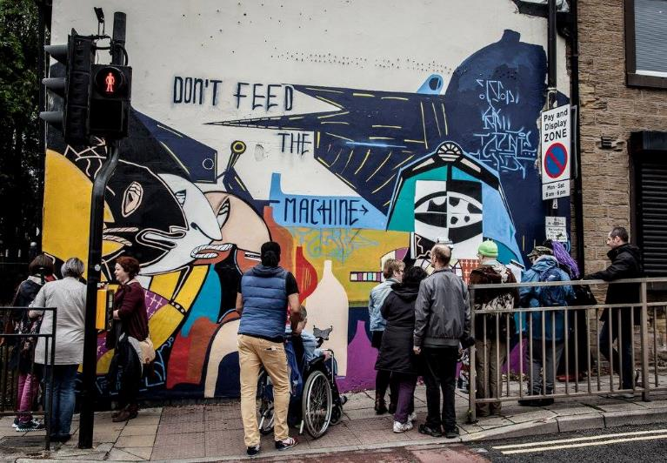
The Re-enchantment of Art
“ We need to become exquisitely skilled engineers of change in our mythologies. If modern aesthetics was inherently isolationist, aimed at disengagement and purity, my sense is that what we all will be seeing over the next few decades is art that is essentially social and purposeful, art that rejects the myths of neutrality and autonomy.”
Suzi Gablik, The Re-enchantment of Art

Slide 70
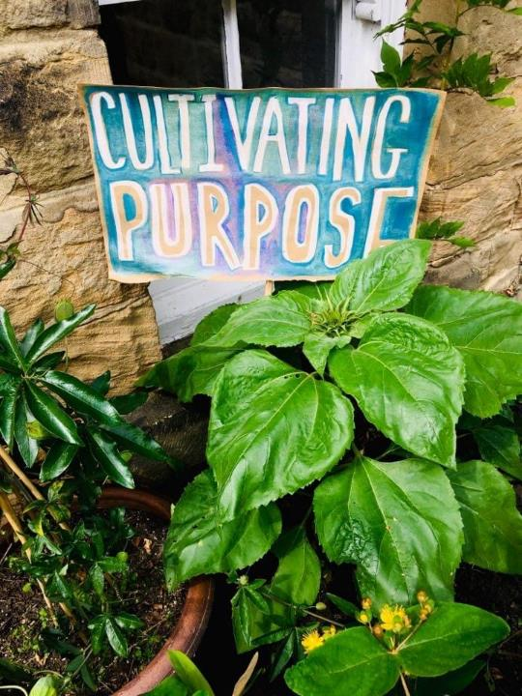
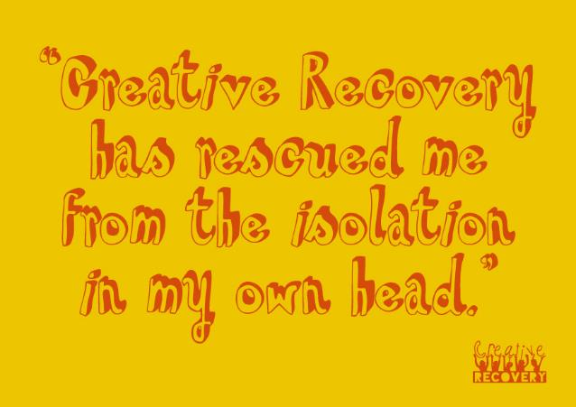
Join us - let’s collaborate!
wearecreativerecovery@gmail.com
01226 805885

Slide 71



A Cultural Call to Arms
www.barnsley-museums.com
Lynn Dunning
Head of Arts & Museums, Barnsley Council

Slide 72

The Health and Wellbeing Benefits of Volunteering with Barnsley Museums
‘I think it honestly saved my life' - Volunteer in conversation with Volunteer Coordinator.
‘Most of the evidence on the impacts of volunteering on the subjective wellbeing of volunteers points to a positive association between the two, including improved life satisfaction, increased happiness and reduced symptoms of depression’ - The Impacts of Volunteering on the Subjective Wellbeing of Volunteers: A Rapid Evidence Assessment, 2020.
‘I enjoyed it very much thank you and yes I am going again next week. It was also nice to meet other people having lost my husband just before Christmas. We sometimes went into the walled garden and sat on a bench and had a picnic, so it was good to go and help to make it look nice for other visitors.’ – Volunteer on volunteering post-covid restrictions.
https://www.artscouncil.org.uk/developing-creativity-and-culture/arts-culture-and-wellbeing
Notes:
Thanks for your time today
We’d like to present some examples of how Barnsley Museums are embedding health and wellbeing into their work as National Portfolio Organisation, supported by Arts Council England. One of our business plan aims is Barnsley Museums will make a strong contribution to the happiness and health & wellbeing of the Borough – reducing GP visits and medication reliance
Volunteering is a key focus for us – there is loads of evidence for the positive impact volunteering can have on people’s health and wellbeing but also the role of arts and culture more generally

Slide 73


Barnsley Cares
Heritage activities in the local care sector
Nominated for Best Age Friendly Outreach Award
Coach Trips to Museums
‘Memory Lane’ ipad sessions
Exercise and reminiscence sessions in care homes
Collection handling sessions
‘I love this group. I can be myself when I come here. Thank you.’ Irene
‘On behalf of myself and all our members can we thank you so very very much for all the hard work you put into offering such a lovely treat and event…We are so lucky to have your support at Butterflies it is greatly appreciated and valued so much.’ Julie Brown Manager Butterflies Dementia Support
Notes:
We know that around 39% of people in Yorkshire and Humber – are either limited or non-digital users - we know there is there is digital poverty in Barnsley –- so we made particular efforts to ensure that we also reached out to the more vulnerable people in our communities with an alternative offer –
Due to the pandemic the Council were able to identify where these people were as they needed help during lockdown, some people were known to us – but others were not so we were able to reach out and engage with new people
the groups we didn’t necessarily aim at that have been captured and benefited. Lockdown has left some people isolated that we would not have identified. We’ve been able to cross barriers of age and accessibility, deliver to those who have work life balance challenges and family circumstances that have been changed in ways we couldn’t have envisioned and bring them into our cultural, offer in ways that they would never have been able to before
Just some examples of what we did
“Barnsley Museums Makes”- I,500 packs – targeted through schools and social services – contained everything required to complete the activity – parents didn’t have to find the materials
20,000 Early Years, KS 1 and KS 2 books and 27,000 Summer Reading Challenge Packs for ALL primary schools in the borough. via Reading Agency – a huge logistical exercise to distribute
“Barnsley Cares” project – 300 reminiscing and activity packs to care homes in the borough, local charity partners such as the Alzheimer’s Society packs included letters of support, a newly created reminiscing puzzle book, Barnsley Top Trumps and DVDs with rare archive footage of Barnsley
Christmas offer to care homes and via Help the Aged- curated DVD of xmas concerts and xmas lights / Barnsley Bright Nights

Slide 74

Schools and Wellbeing
https://barnsleymuseums.art.blog/2021/02/01/wellbeing-resources-for-children/
Notes:
Range of online resources relating to mindfulness and activities for physical wellbeing

Slide 75

Draw Hope
https://www.youtube.com/watch?v=Un2I6fFm_lE
‘I referred one of my clients to the art group that you are running on Saturdays. I have just had a conversation with her mum, and I just wanted to pass over some very positive feedback. She said that A is absolutely thriving in the class, and she has never seen her so enthusiastic or this happy in a long time. She looks forward to Saturdays and has said that she will be gutted once the classes come to an end. So I just wanted to say a great big thank you. Your class has made a massive difference to her’
Notes:
A project for young people inspired by the Sadler Collection of drawing at the Cooper Gallery aimed at improving mental health, flexed for delivery during the pandemic

Slide 76














Kindred – Covid Recovery Fund
KINDRED
Engaging Barnsley families with multiple and complex needs
Notes:
Kindred
2020 – 2022
Commissioned by Healthier Communities Service, Barnsley Council
Funded by Covid Recovery Fund, Barnsley Council
Kindred encouraged families with multiple and complex needs with mixed age children (11 – 18yrs), to view cultural and heritage activity as something they can positively engage in together, to raise aspirations, build skills and improve wellbeing. This programme came at a time of particular need for these families, at higher risk of being adversely affected by Covid-19 when demand for drug misuse-and domestic abuse services is rising. Barnsley Museums brought together nine social services and external organisations to recruit and refer families. During the pandemic, 20 families attended, with 59 individuals taking part from 13 districts around Barnsley.
Kindred offered a two-day programme of outdoor activities including craft, art, nature identification and micro-volunteering at Cannon Hall and Worsbrough Mill Museums. A positive learning experience and an introduction to family volunteering, education and training was provided. Support to access meaningful progression routes was offered to families, in partnership with twelve internal and external agencies. Evaluation evidenced the impact for all the families was 100% positive with many creating new social support networks and 70% expressing interest and enquired into career and volunteering opportunities.

Slide 77




Fusion
The fundamental principle at the core of FUSION is that…
EVERY CHILD IN BARNSLEY HAS AN OPPORTUNITY TO ACCESS ARTS, HERITAGE & CULTURAL ACTIVITY
Partnership brings together education, arts, heritage, cultural, creative, BMBC - health, communities, employment and skills to develop strategic plans & facilitate activity
PRIORITIES 2022/23:
Win the hearts and minds of the education sector so pupils have access to quality arts provision.
Enable Youth Voice to sit at the heart of Fusion's strategy and practice.
Creative careers strategy that focuses on progression and employability
Early Years & Community embed into Festival of Joy
FESTIVAL OF JOY 2023 - for ALL children, young people & families in Barnsley
Notes:
Overview:
Established in 2017 in response to an Arts Council England/Department for Education challenge. That challenge was to improve the alignment of cultural education for children and young people through local partnerships. They wanted to bring people together from arts, heritage, culture and education sectors to work together to advocate the value of the arts, culture and creativity.
With the aim of working collectively to deliver a cohesive offer in their local area.
Fusion, Barnsley’s Cultural Education Partnership, aims to increase access to arts and culture for ALL young people across Barnsley through delivery of strategy that positions Fusion as the cultural glue across the borough’s education sector. The partnership has been working with key partners from the education sector, youth services, Public Health, Education, Early Start and Prevention to find ways to support CYP health and wellbeing through increased access to arts, culture and creativity.
This has led to collaborations including the provision of the online holiday club Creative Camps – which connected local families with over 13 artists, creatives and cultural practitioners with a focus on identify and finding a new creative outlet; CPD to improve CYP’s wellbeing through creative and sensory exploration and connecting partners with opportunities to enhance and support CYP across the borough through a wide range of creative projects and initiatives.
June 2023 will see Fusion’s flagship project the Festival of Joy, Barnsley’s first ever Children’s Festival. The team is currently working towards the Day of Joy, activity that gives young people the chance to programme their own day of creative arts.

Slide 78




Barnsley Museums / National Trust / Northern College Partnership
The Community Partners Scheme at Wentworth Castle Gardens (WCG) aims to partner with local organisations to overcome some of the barriers potential visitors might face and to support the positive health and wellbeing of our communities.
Just one example of how we work together as a partnership to make a difference and reach people who wouldn't otherwise engage
‘One lady in particular stood out today… [she] has not stepped out of her house since March 2020 due to Covid, and before that she was a sole carer for her husband so really has had a very sheltered life. During our walk, she wanted to touch and smell every plant and flower that she passed, she wanted to sit and listen to every bird call that she could and just appreciate the fresh air. Today meant a lot to that lady and she was really grateful.’ (Age UK Group Leader )

Slide 79

Wellbeing
Links

