Slide 1
Let’s hear your voice

Slide 2
What is Let’s Hear Your Voice all about?
Let’s Hear Your Voice is a health and lifestyle survey.
Let’s Hear Your Voice will be completed by pupils in year 4, 6, 8, 10 and post 16 across Barnsley.
The survey will ask you different questions about your health, things in your life, your school day, your safety and how you feel.
This survey will go out every two years so you will probably see it again in the future!
Notes:
Let’s Hear Your Voice is a health and lifestyle survey that has been created by the Children’s Public Health Team.
Let’s Hear Your Voice will be completed by pupils in year 4, 6, 8, 10 and post 16 across Barnsley
The survey will ask you different questions about your health, things in your life, your school day, your safety and how you feel.
Barnsley Council would like the survey to be answered every two years so you will probably see this survey again in the future!

Slide 3
Why is it so important?
We want to understand what is going on in the lives of children and young people so that we can do our best to help you live happy healthy lives.
Your school and other organisations can use the information from the survey to help support you in the best way they can.
By answering the questions it will give you a chance for your voice to be heard about the things that matter to you.
The survey will help us to understand any issues in Barnsley and we can then work hard to address them.

Slide 4
What will Let’s Hear Your Voice ask me?
The survey will ask you questions on different topics such as physical activity, relationships, hobbies, feelings.
It is not a test there are no right or wrong answers.
Please ask for help if you get stuck.
Please answer honestly.

Slide 5
What does it look like?
None of the questions need you to write anything. They are all multiple choice questions.
There are two styles of question:
A multiple-choice question (where you select one or more answers), and
A sliding scale question.

Slide 6
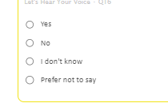
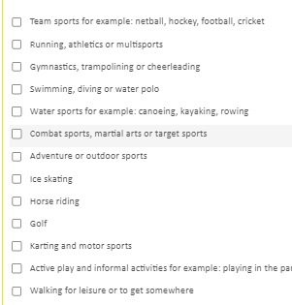
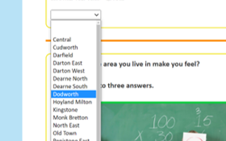
Here are some examples:
others might just want one.
Some questions might let you select more than one answer
There are also some questions which have a drop-down menu to choose from
Notes:
There are different types of multiple choice questions in the survey.
Some will allow you to choose more than one answer
Other questions will just let you select one answer
There are also some questions which have a drop down menu where you can choose your answer

Slide 7
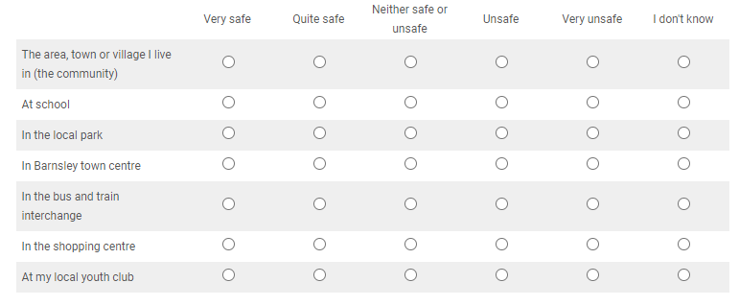
Example
Some questions might look like this, with lots of options
All you need to do is tick one box on each line.
Notes:
Some of the questions might look like this where there are lots of options.
This questions is asking how safe you feel in a variety of places. All you need to do is look at the different places down the left hand columnand think about how safe you feel in each of them. So to answer this question you would need to tick one box on each line.

Slide 8
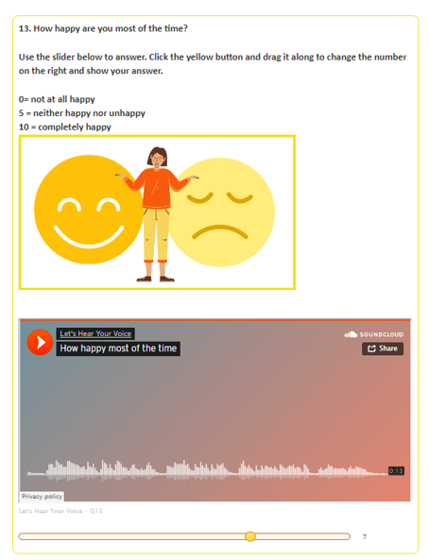
A sliding scale question
This is the question
This orange button will play the audio version of the question if you need it
This is the slider – move the circle along the line to give yourself a score out of 10
Notes:
This is the question. It might also have a description of some of the words or phrases used to help you understand it
This orange button will play the audio version of the question if you need it
This is the slider – to answer this question you would move the circle along the line to say where you are on a scale of 1-10
The number at the end of the scale is your answer will be – in this example the circle is set to 7 out of 10

Slide 9
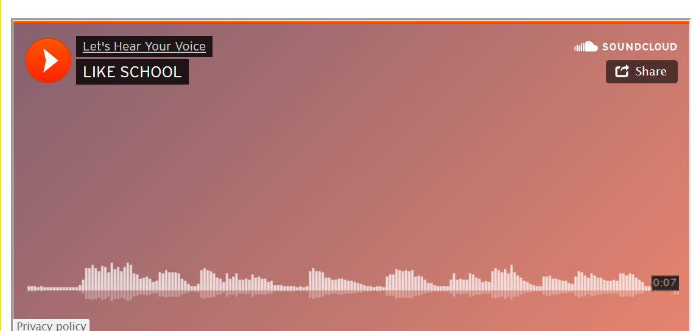
How do I take part?
Let’s Hear Your Voice questions are all completed on a computer or
tablet.
You can skip any question that you do not understand or do not want to answer.
Don’t forget to ask for help if you need it
You do not have to take part if you don't want to - just speak to your teacher about it.
if you prefer to hear the question instead of read it each question has recorded version. Just press the orange play button to listen to it
Notes:
Let’s Hear Your Voice questions are all completed on a computer or
tablet.
You can skip any question that you do not understand or do not want to answer.
If you need any extra help with all or parts of it, you can ask a teacher or school staff member to help you.
Each question has an audio version. This means that you can play them out loud or into some headphones if it helps you to understand the question better.

Slide 10
Will anyone see my answers?
Let’s Hear Your Voice is completely anonymous
Please answer as honestly as you can. There are no right or wrong answers.
The council will keep your answers safe on their computers.
Notes:
Let’s Hear Your Voice is completely anonymous – this means that when you answer the questions in the survey no one will know that it is you. We will not ask you for your name or address
This means you can answer the questions as honestly as you can – there is no need to feel worried and there are no right or wrong answers.
Your school and the council will be able to see responses to the survey to help them understand how best to support you but they will never know who answered what.

Slide 11
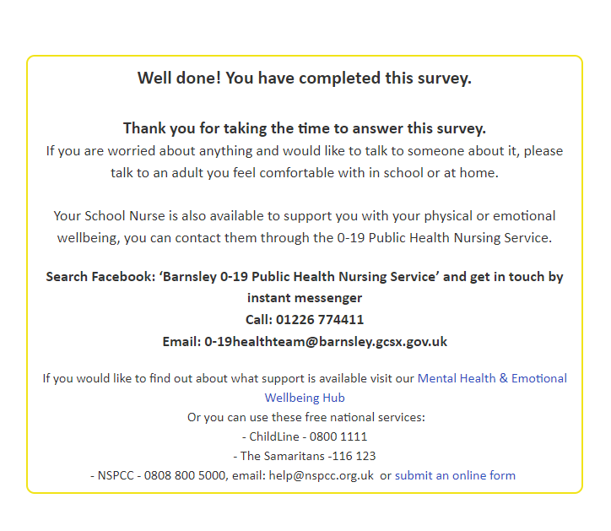
How can I get help after I have taken part?
If you finish the survey and want to speak to someone – you can speak with a teacher or other staff member that you feel comfortable talking to
If you want help from other services and don’t want to speak to a teacher or school staff member there are links and phone numbers at the end of the survey for you to use
Notes:
When you finish the survey the last page will contain a link to a completely separate form.
This form is for anyone who would like some extra help or support from local services.
Simply enter your name and a contact phone number or email and the children’s team will get in touch to see how they can help you
Do not worry – this form will not link to your answers to the survey.

Slide 12
Thank you, for listening

