Slide 1
pupil health and lifestyle survey

Slide 2
What is it all about?
Let’s Hear Your Voice is a health and lifestyle survey
We want pupils in year 4, 6, 8, 10 and post 16 to take part.
The survey will ask you different questions about your health and lifestyle
Barnsley Council would like the survey to be answered every two years so you will probably see this survey again in the future!
Notes:
Let’s Hear Your Voice is a health and lifestyle survey that has been created by the Children’s Public Health Team.
Let’s Hear Your Voice will be completed by pupils in year 4, 6, 8, 10 and post 16 across Barnsley.
The survey will ask you different questions about your health, things in your life, your school day, your safety and how you feel.
Barnsley Council would like the survey to be answered every two years so you will probably see this survey again in the future!

Slide 3
Why is it so important?
We want to better understand the young people of Barnsley
We would like to use the information we collect with your school and wide young people's services to ensure we are supporting you to live your best life!
By answering the questions it will give you a chance for your voice to be heard about the things that matter to you.
The survey will help us to understand any issues in Barnsley and we can then work hard to address them.

Slide 4
What will Let’s Hear Your Voice ask me?
The survey will ask you questions on different topics such as physical activity, relationships, hobbies, feelings.
It is not a test there are no right or wrong answers.
Please ask for help if you get stuck.
Please answer honestly.

Slide 5
Personal questions
Some of the questions are on topics which might feel quite personal or triggering.
There are some questions about drugs, alcohol, smoking and sexual activity.
No one will know your answers – all the responses are completely anonymous.
If you don’t feel comfortable answering a question you can move to the next question

Slide 6
Triggering questions
Some of the questions may trigger emotions or may make you think about seeking help or support.
There are links to support services on some of the questions we have deemed as potentially triggering
You can also speak to your school pastoral lead for some support if you need it.
Notes:
Note for schools – please include named lead on slide to ensure pupils know who to go to.

Slide 7
What does it look like?
None of the questions need you to write anything. They are all multiple choice questions.
There are two styles of question:
A multiple-choice question (where you select one or more answers)
A sliding scale question.
Notes:
None of the questions will require you to write anything they are all what we call multiple choice questions where you simply choose the answer from the options given.
There are a few different styles of question so let’s take a look at them in more detail

Slide 8
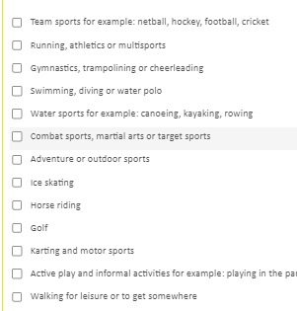
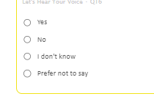
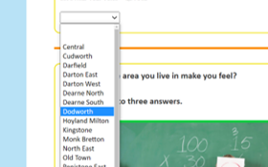
Different styles of multiple-choice questions
Some questions might let you tick more than one answer
others might just want one.
There are also some questions which have a drop-down menu to choose from
Notes:
There are different types of multiple choice questions in the survey.
Some will allow you to choose more than one answer
Other questions will just let you select one answer
There are also some questions which have a drop down menu where you can choose your answer

Slide 9
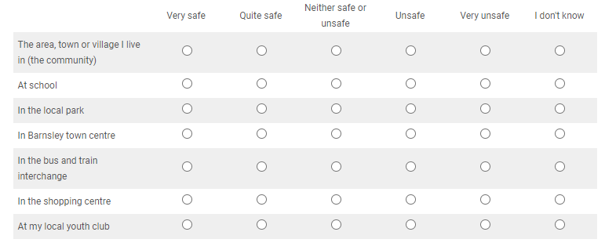
Different styles of multiple-choice questions
Some questions might look like this, with lots of options
All you need to do is tick one box on each line.
Notes:
Some of the questions might look like this where there are lots of options.
This questions is asking how safe you feel in a variety of places. All you need to do is look at the different places down the left hand columnand think about how safe you feel in each of them. So to answer this question you would need to tick one box on each line.

Slide 10
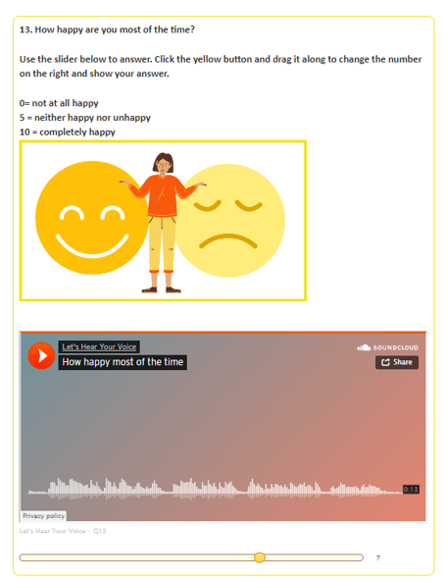
Sliding scale questions
This is the question.
​This orange button will play the audio version of the question if you need it
This is the slider – move the circle along the line to give yourself a score out of 10
Notes:
This is the question. It might also have a description of some of the words or phrases used to help you understand it
This orange button will play the audio version of the question if you need it
This is the slider – to answer this question you would move the circle along the line to say where you are on a scale of 1-10
The number at the end of the scale is your answer will be – in this example the circle is set to 7 out of 10

Slide 11
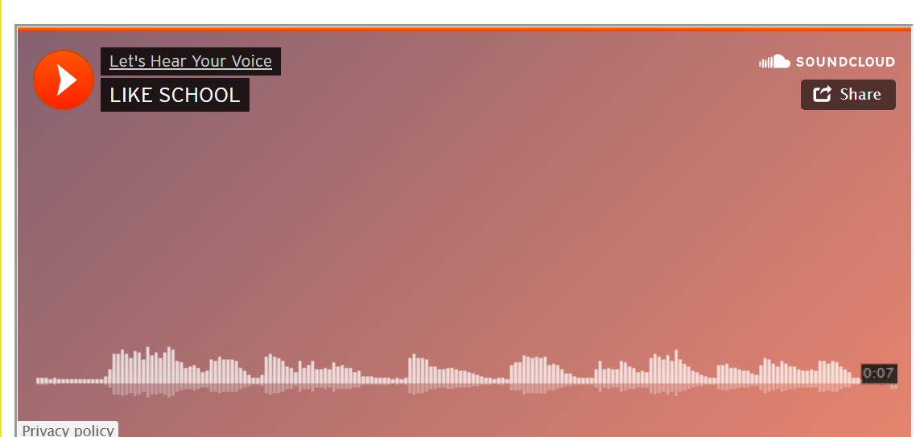
How do I take part?
Let’s Hear Your Voice questions are all completed on a computer or
tablet.
You can skip any question that you do not understand or do not want to answer.
Don’t forget to ask for help if you need it
If you prefer to hear the question instead of read it, each question has a recorded version. Just press the orange play button to listen to it.
You do not have to take part if you don't want to - just speak to your teacher about it.
Notes:
Let’s Hear Your Voice questions are all completed on a computer or
tablet.
You can skip any question that you do not understand or do not want to answer.
If you need any extra help with all or parts of it, you can ask a teacher or school staff member to help you.
Each question has an audio version. This means that you can play them out loud or into some headphones if it helps you to understand the question better.

Slide 12
Will anyone see my answers?
Let’s Hear Your Voice is completely anonymous
Please answer as honestly as you can. There are no right or wrong answers.
The council will keep your answers safe on their computers.
Notes:
Let’s Hear Your Voice is completely anonymous – this means that when you answer the questions in the survey no one will know that it is you. We will not ask you for your name or address
This means you can answer the questions as honestly as you can – there is no need to feel worried and there are no right or wrong answers.
Your school and the council will be able to see responses to the survey to help them understand how best to support you but they will never know who answered what.

Slide 13
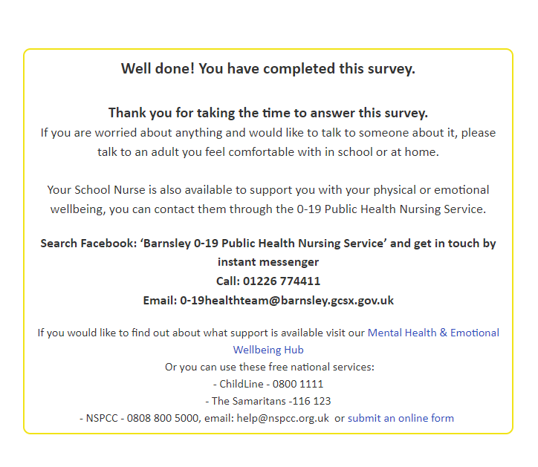
How can I get help after I have taken part?
If you finish the survey and want to speak to someone you can speak to the appropriate staff member in your school – this might be a pastoral lead, teacher or head of year, whoever you feel most comfortable speaking with.
If you want to request support privately from local services there are contact details to various services
These include links to local and national mental health support services and the school nursing team
Notes:
When you finish the survey the last page will contain a link to a completely separate form.
This form is for anyone who would like some extra help or support from local services.
Simply enter your name and a contact phone number or email and the children’s team will get in touch to see how they can help you
Do not worry – this form will not link to your answers to the survey.

Slide 14
Thank you for your support and participation

